Slide 1
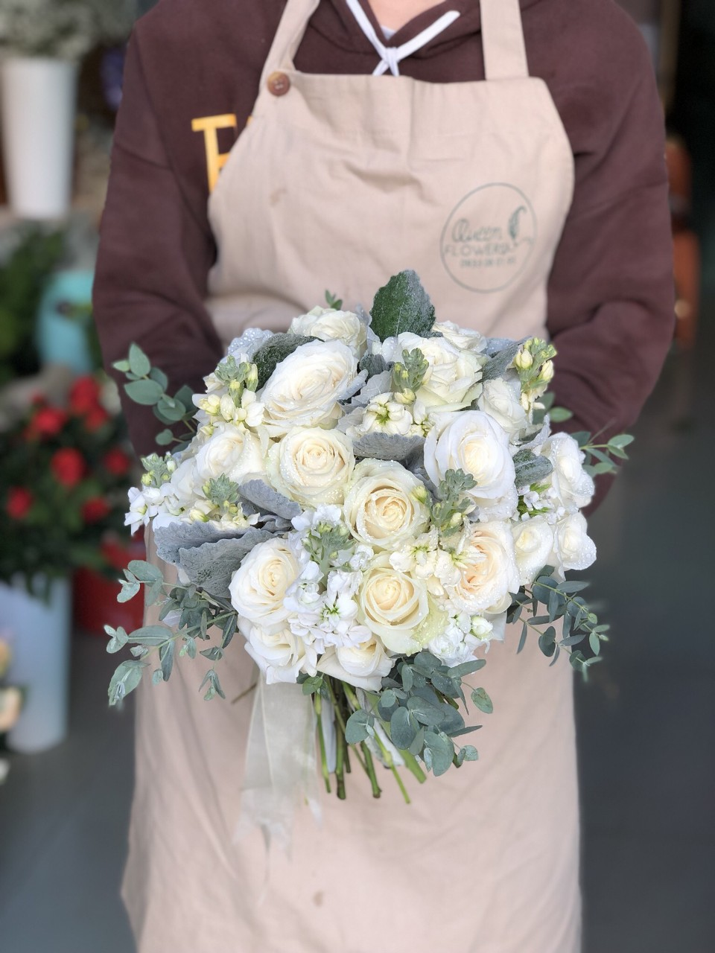
Queen Flowers 0933 06 01 95
Notes:
Hoa cuoi

Slide 2
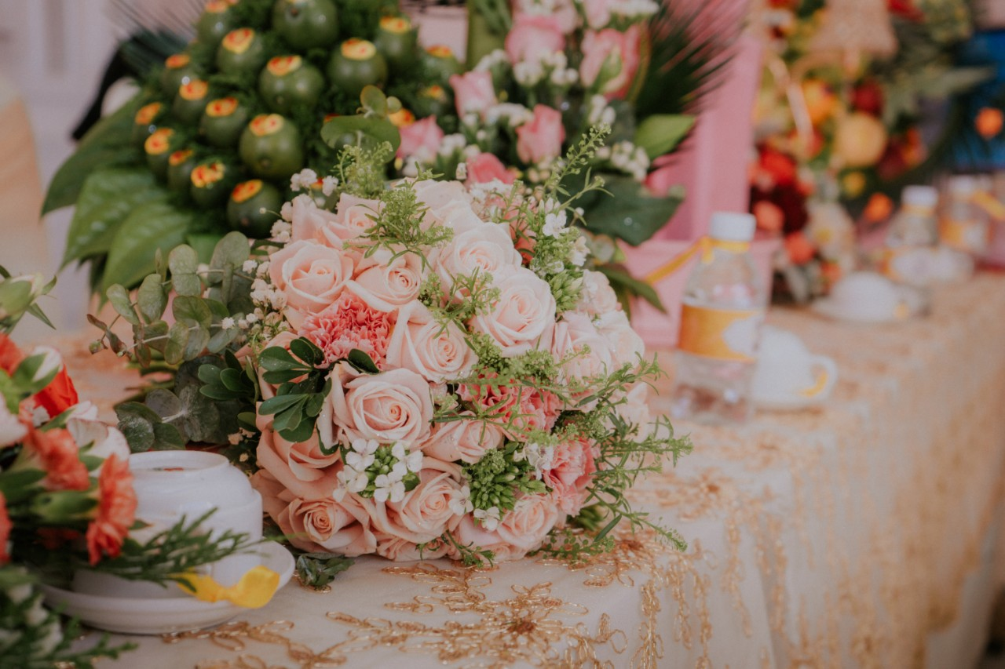
Queen Flowers 0933 06 01 95

Slide 3
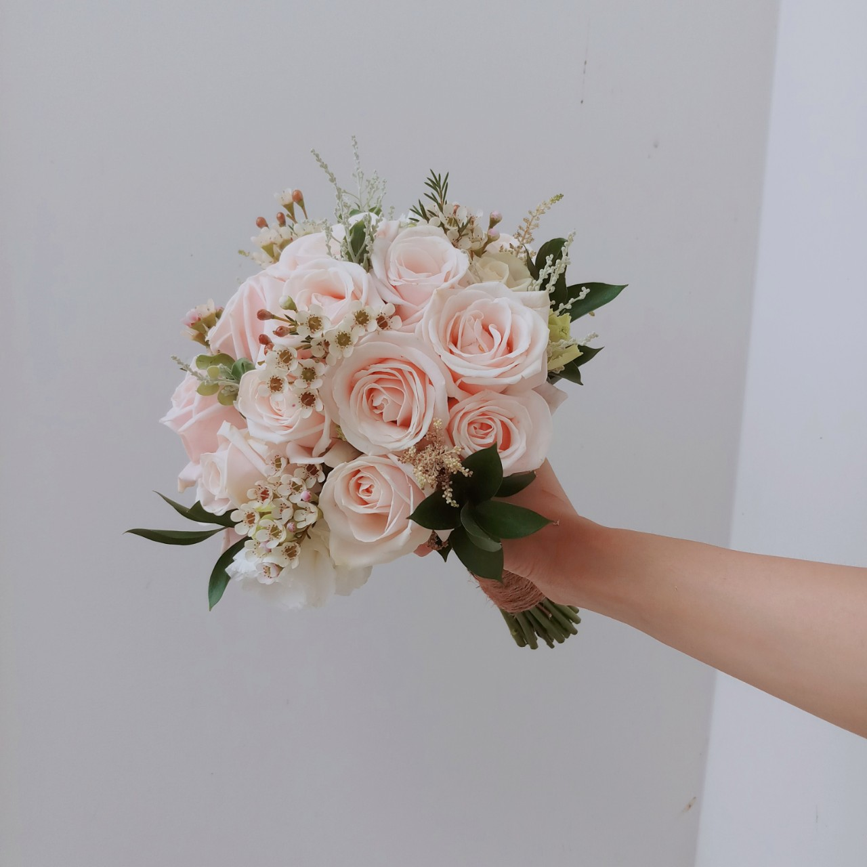
Queen Flowers 0933 06 01 95

Slide 4
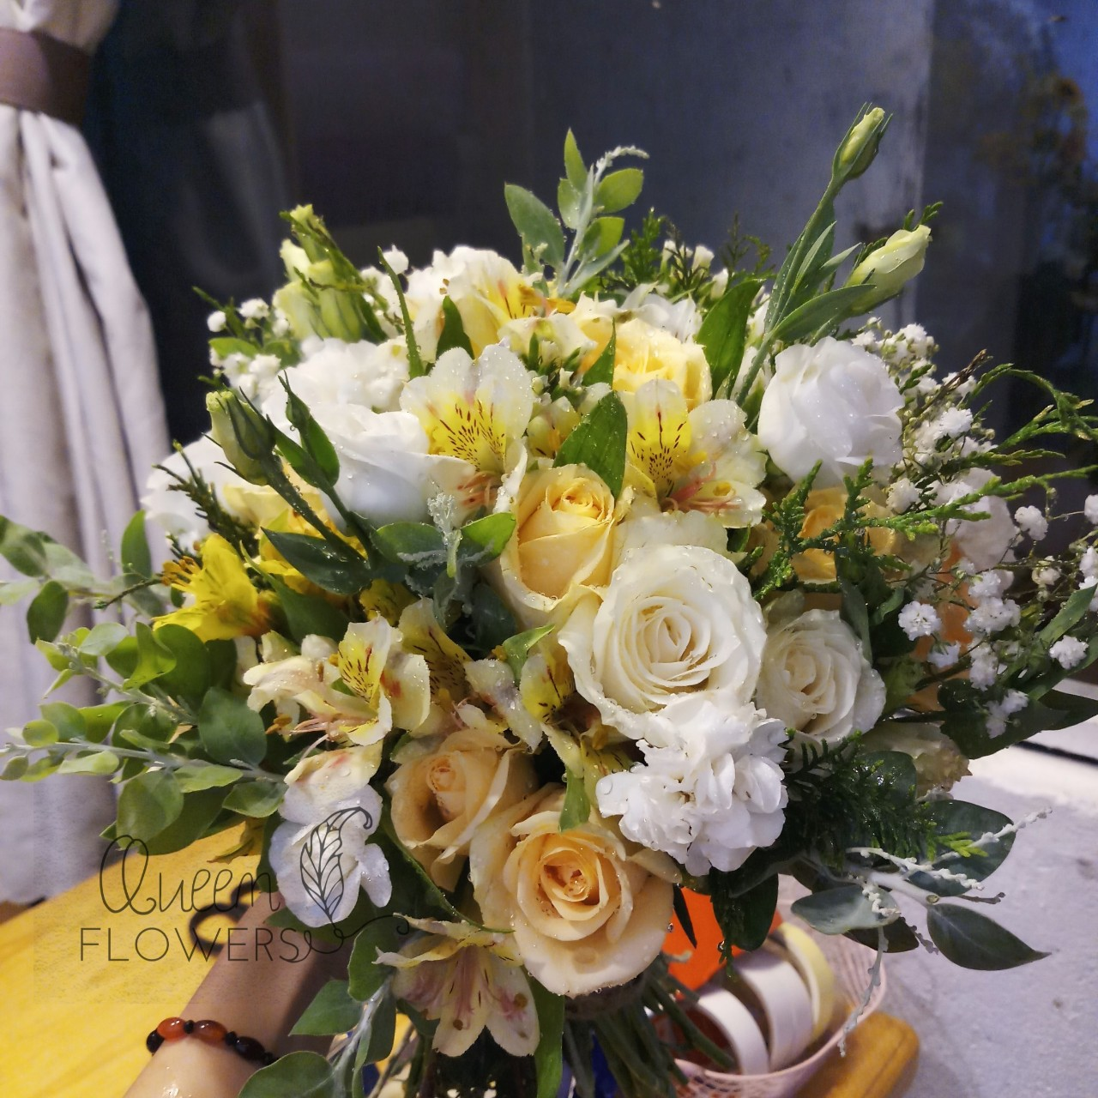
Queen Flowers 0933 06 01 95

Slide 5
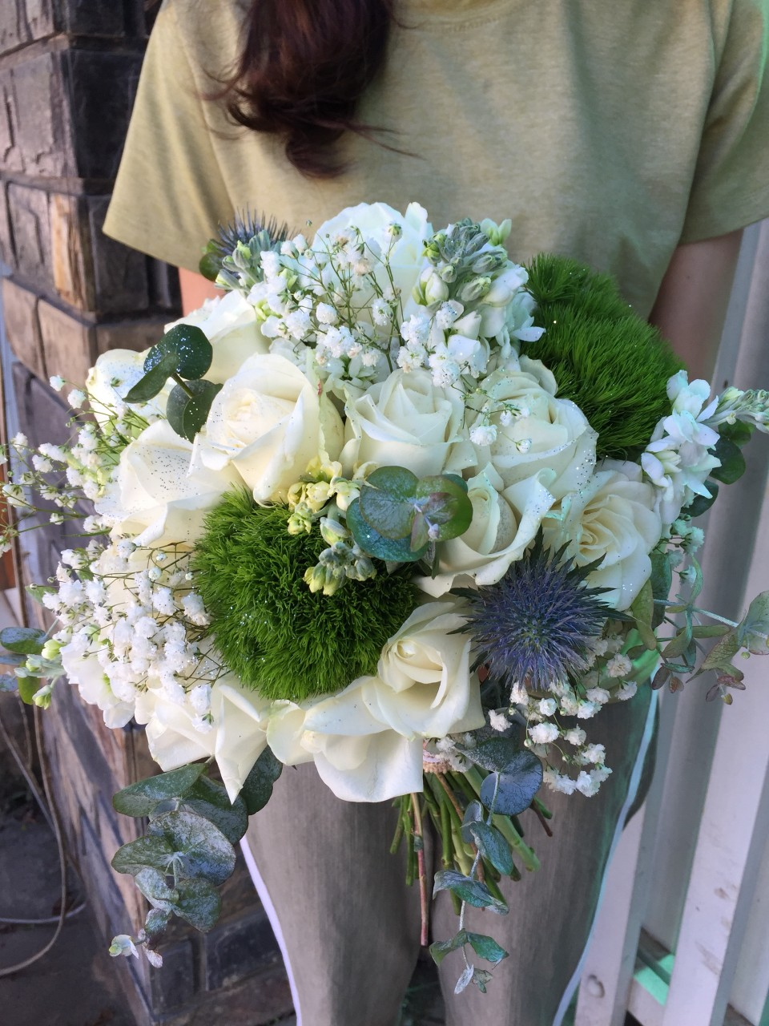
Queen Flowers 0933 06 01 95

Slide 6
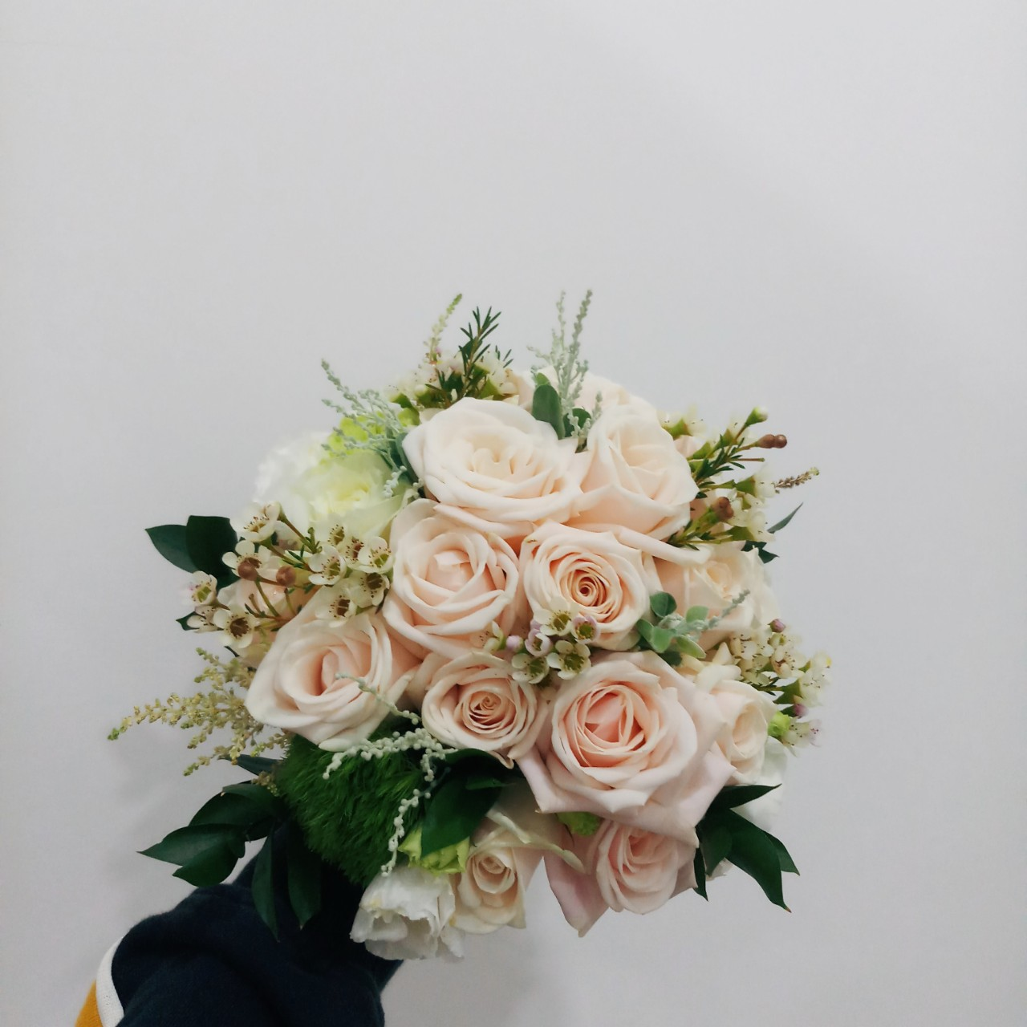
Queen Flowers 0933 06 01 95

Slide 7
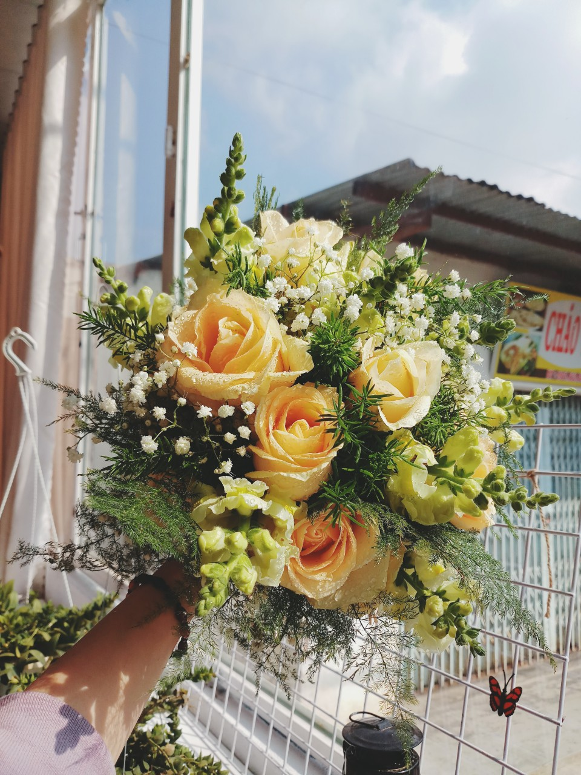
Queen Flowers 0933 06 01 95

Slide 8
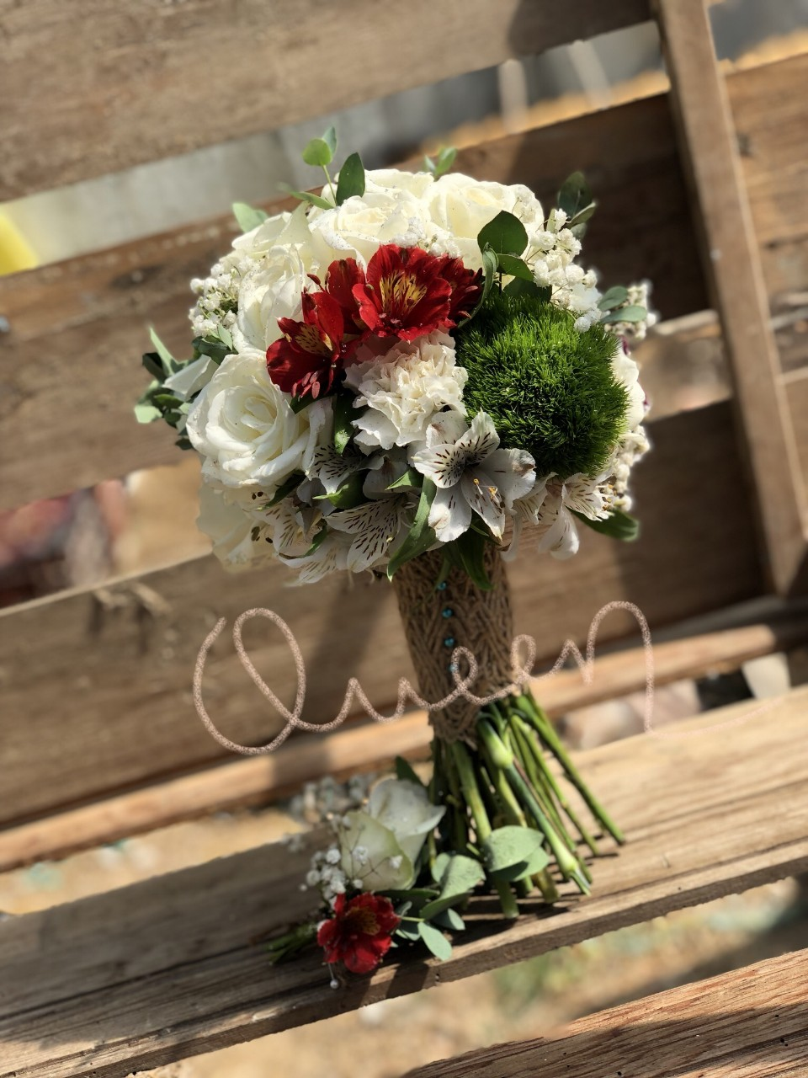
Queen Flowers 0933 06 01 95

Slide 9
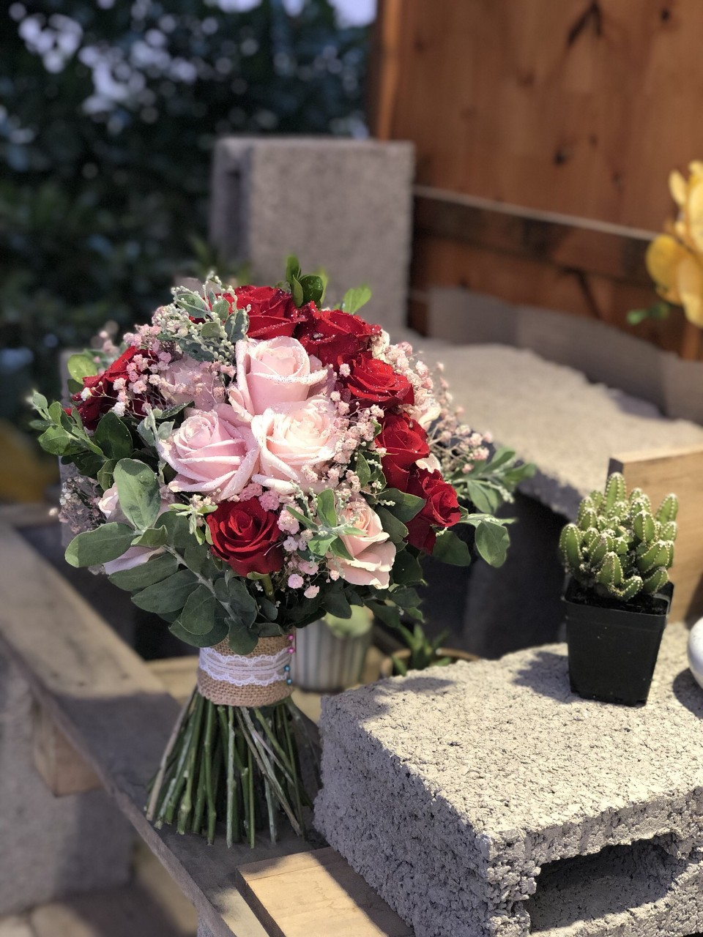
Queen Flowers 0933 06 01 95

Slide 10
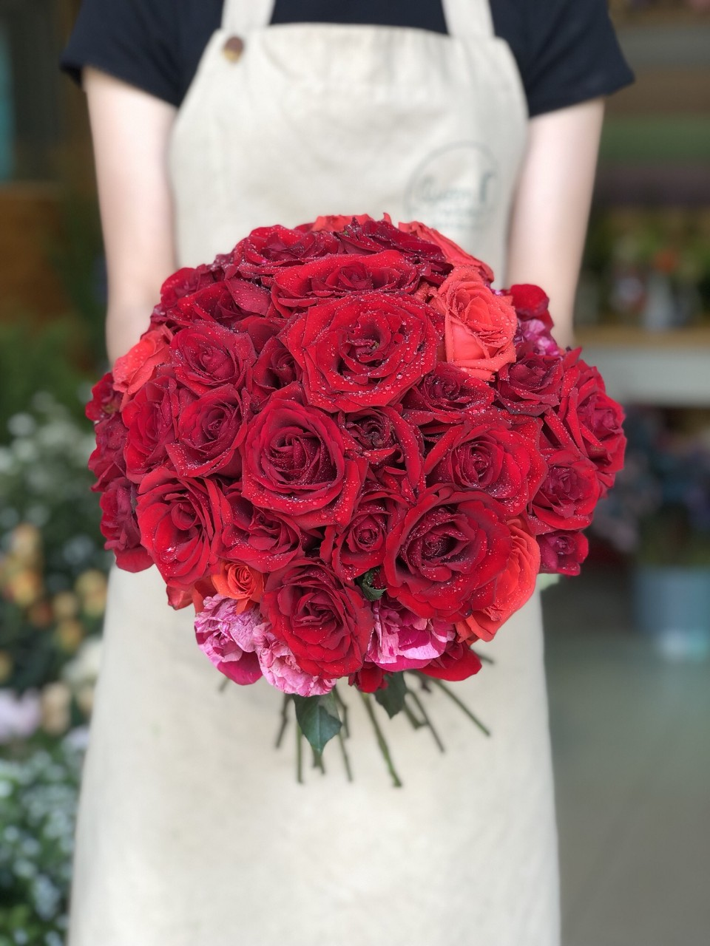
Queen Flowers 0933 06 01 95

Slide 11
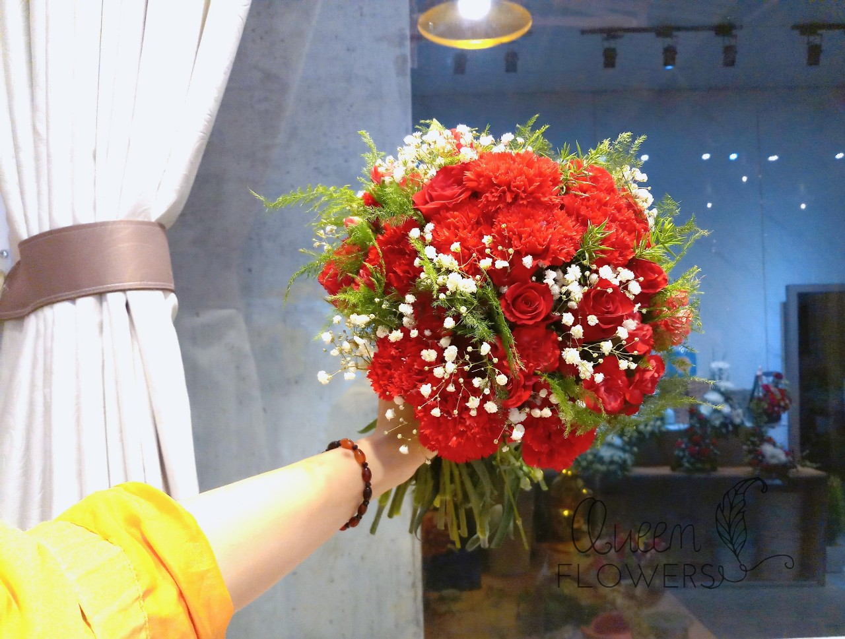
Queen Flowers 0933 06 01 95

Slide 12
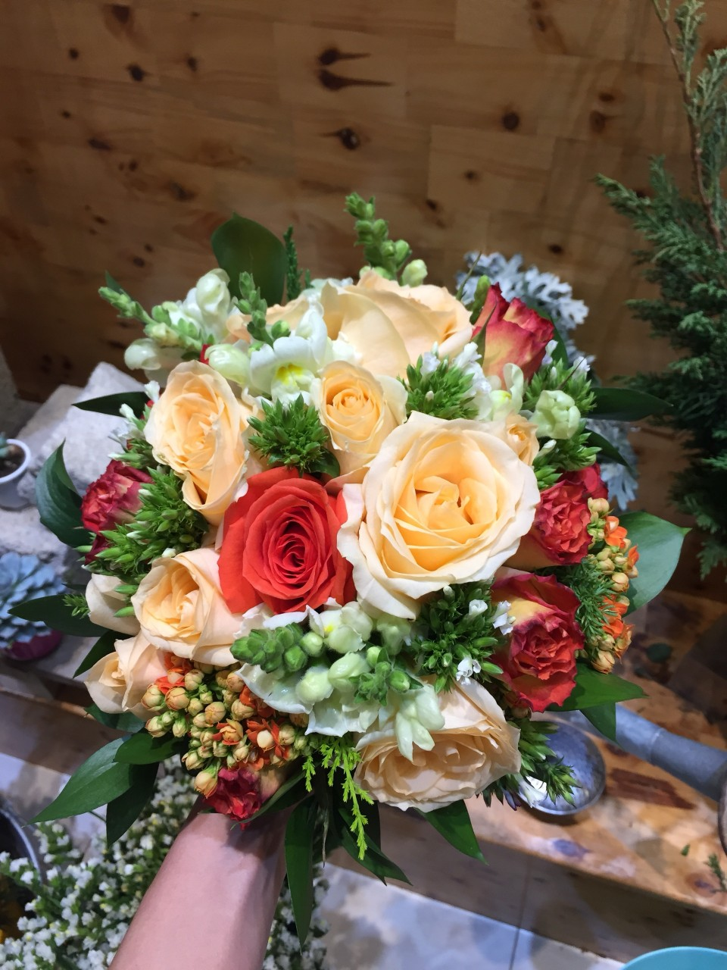
Queen Flowers 0933 06 01 95

Slide 13
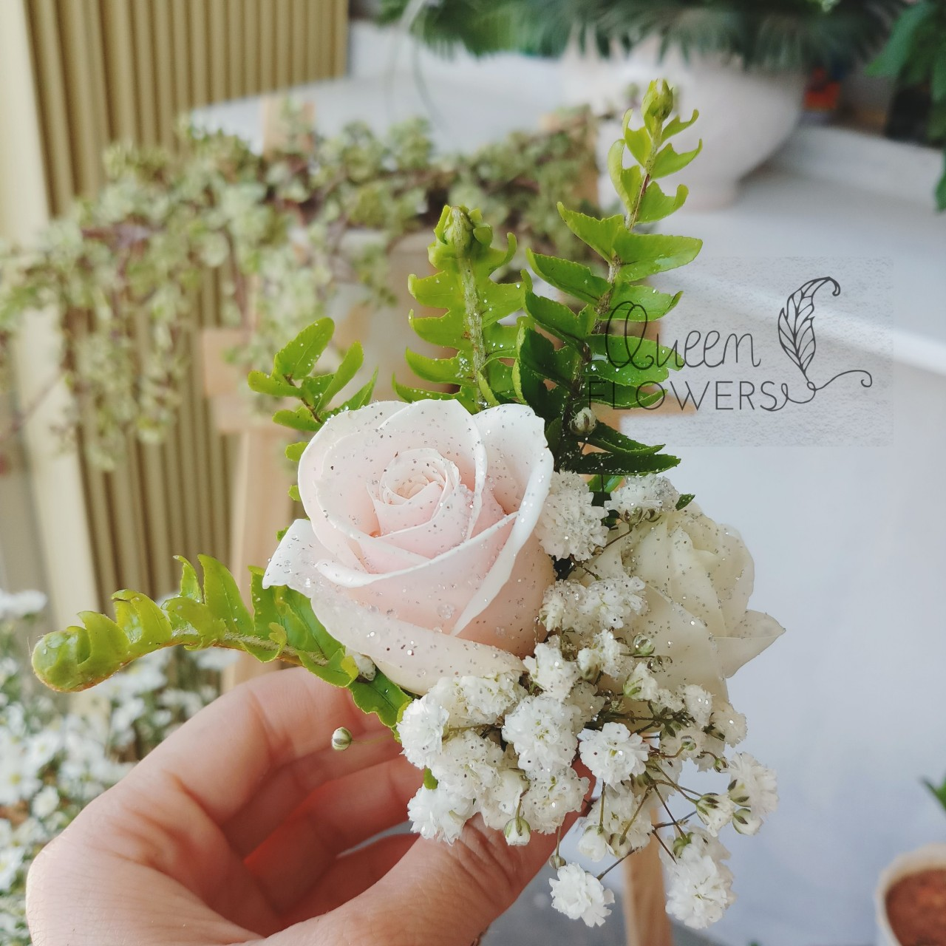
Queen Flowers 0933 06 01 95

Slide 14
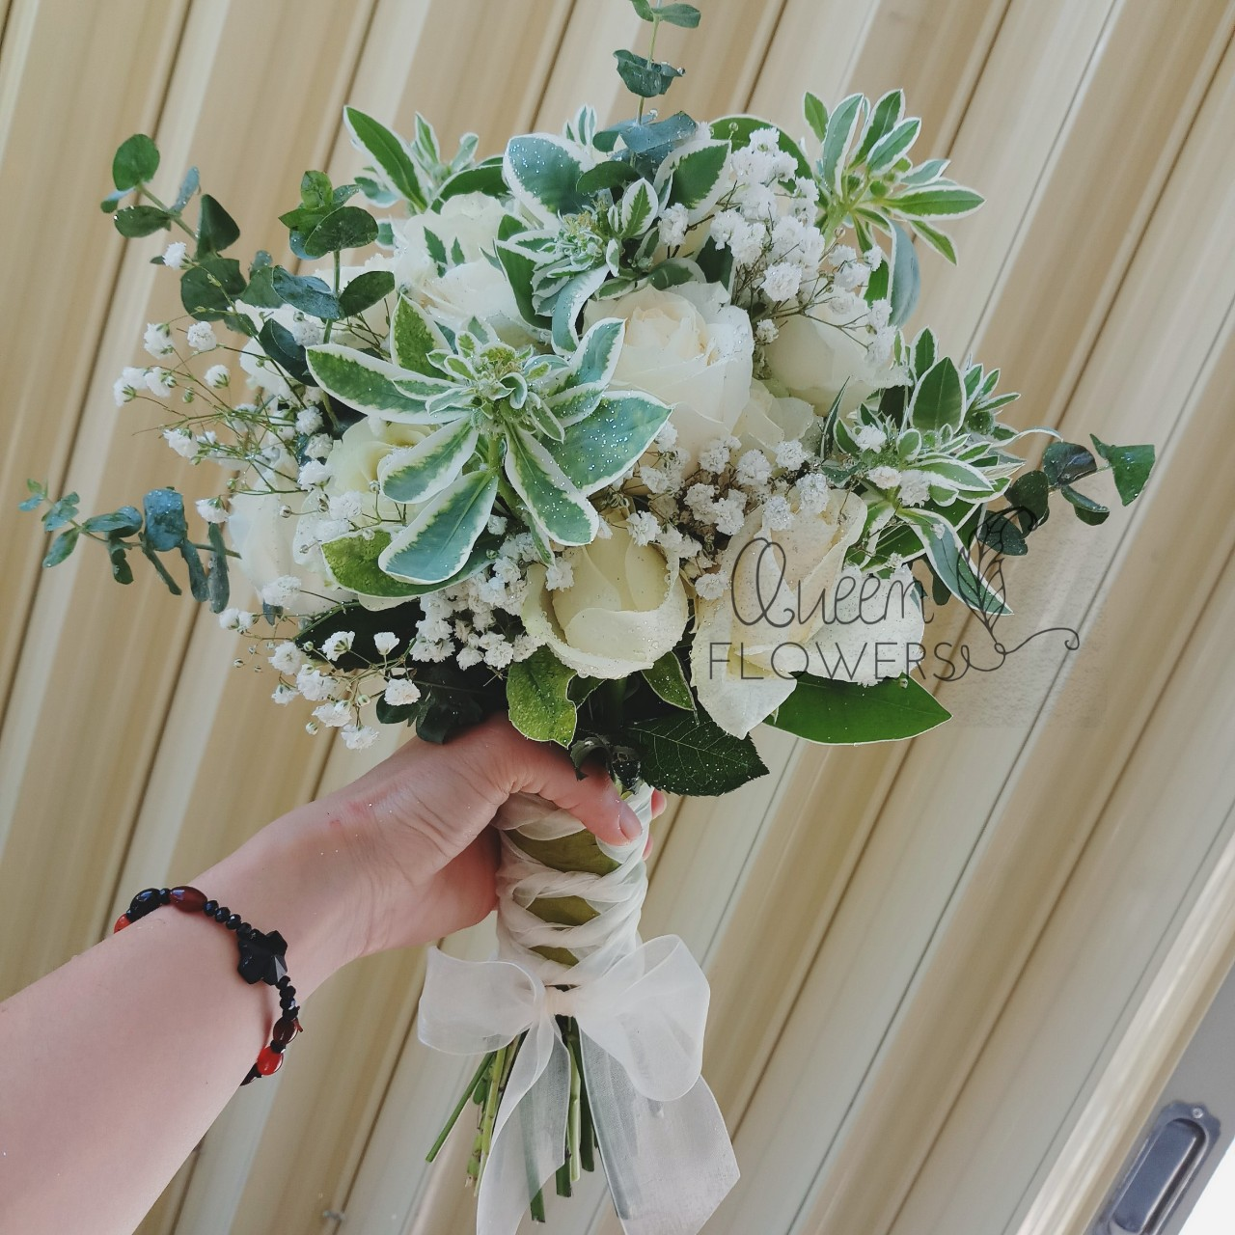
Queen Flowers 0933 06 01 95

Slide 15
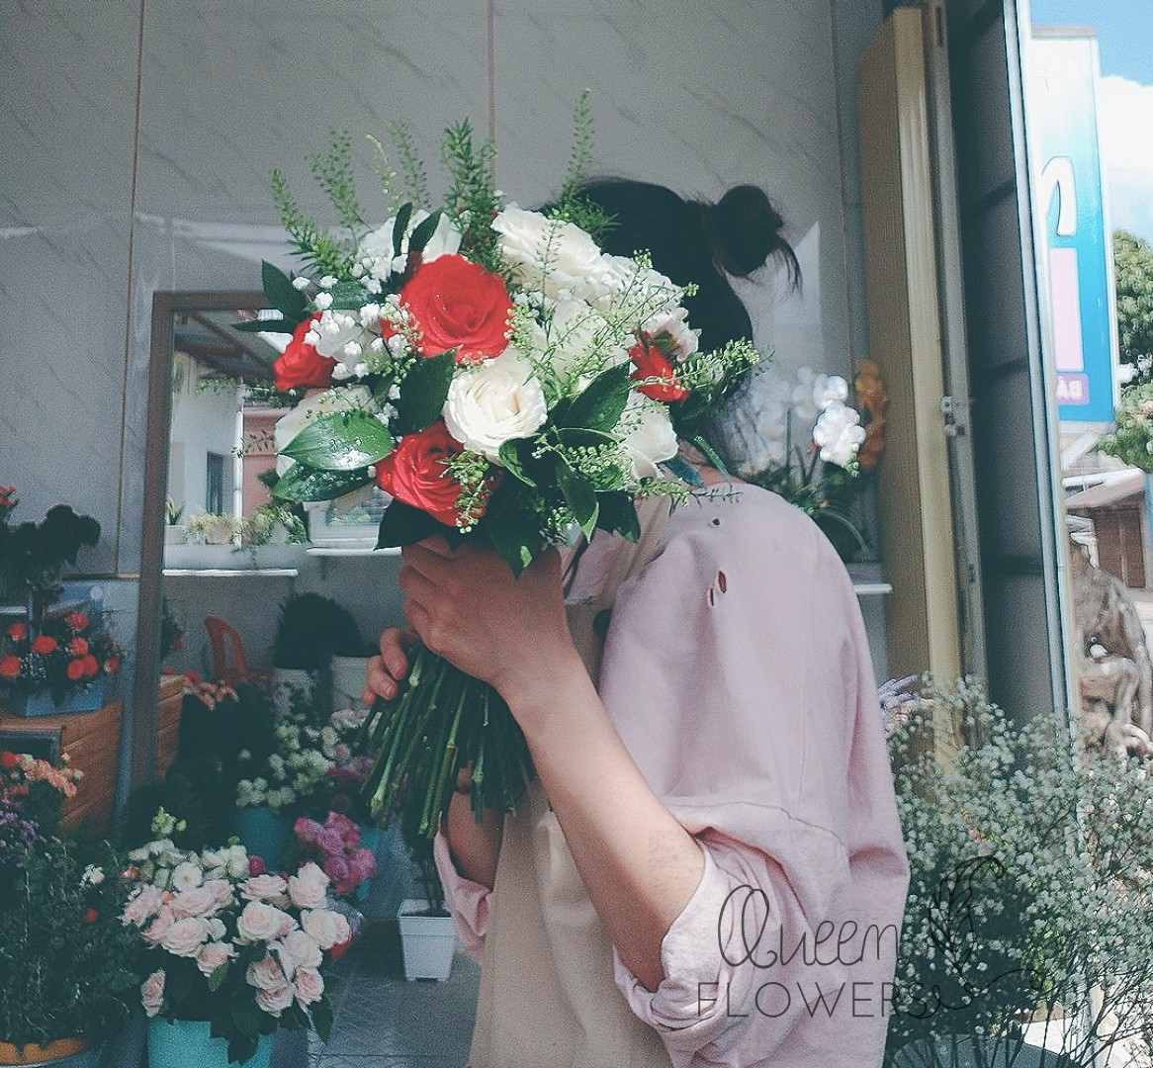
Queen Flowers 0933 06 01 95

Slide 16
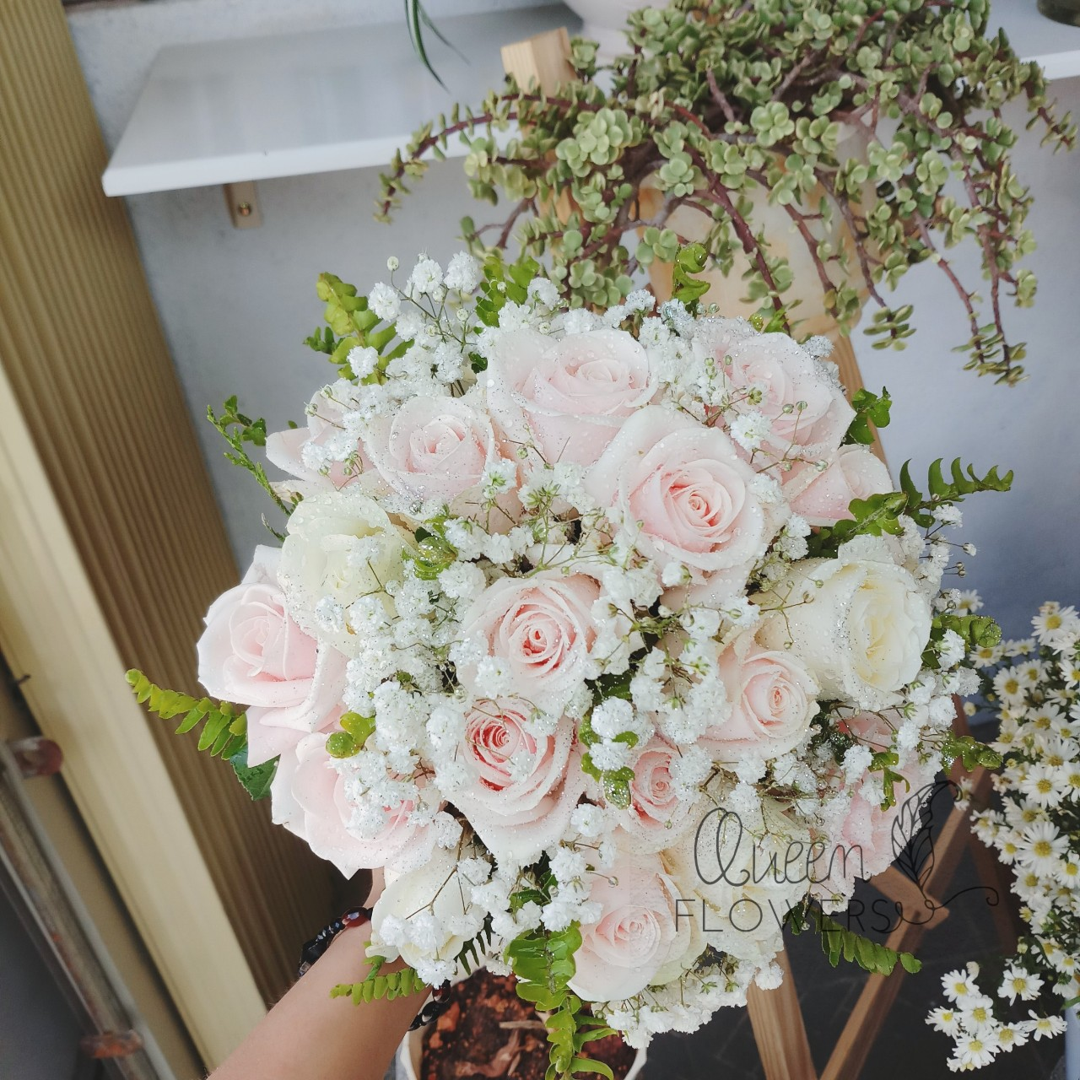
Queen Flowers 0933 06 01 95

Slide 17
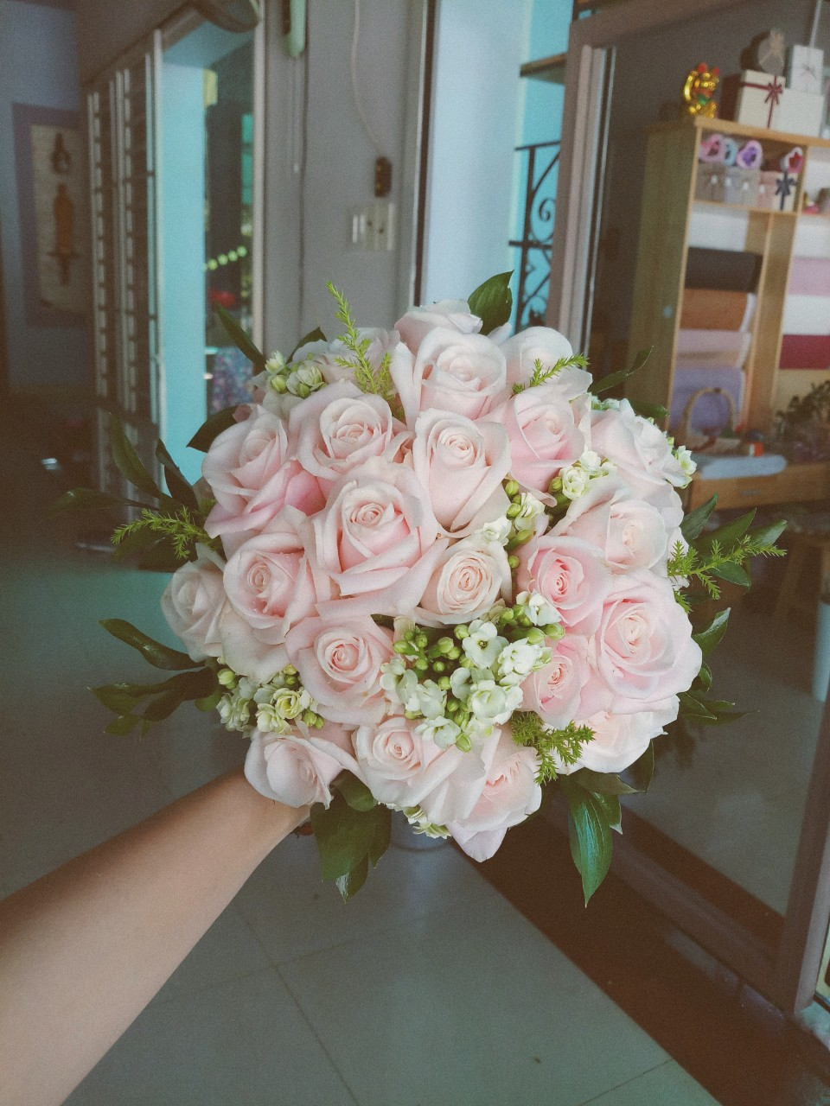
Queen Flowers 0933 06 01 95

Slide 18
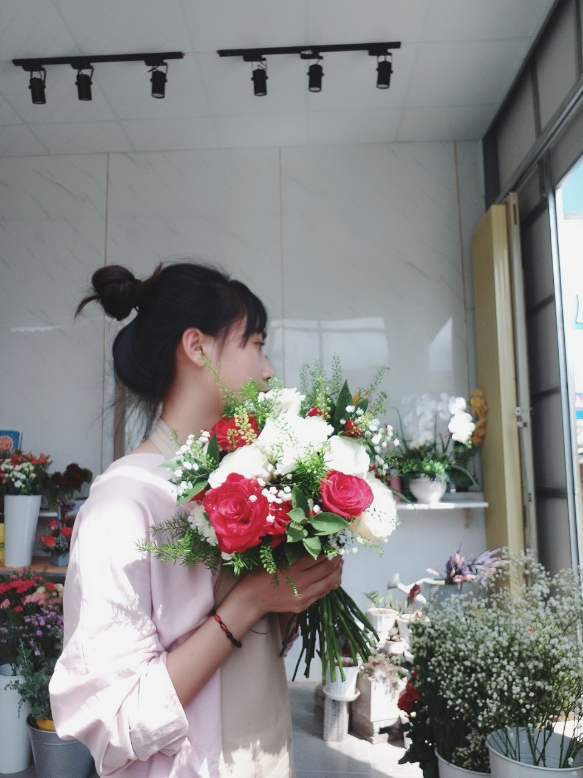
Queen Flowers 0933 06 01 95

Slide 19
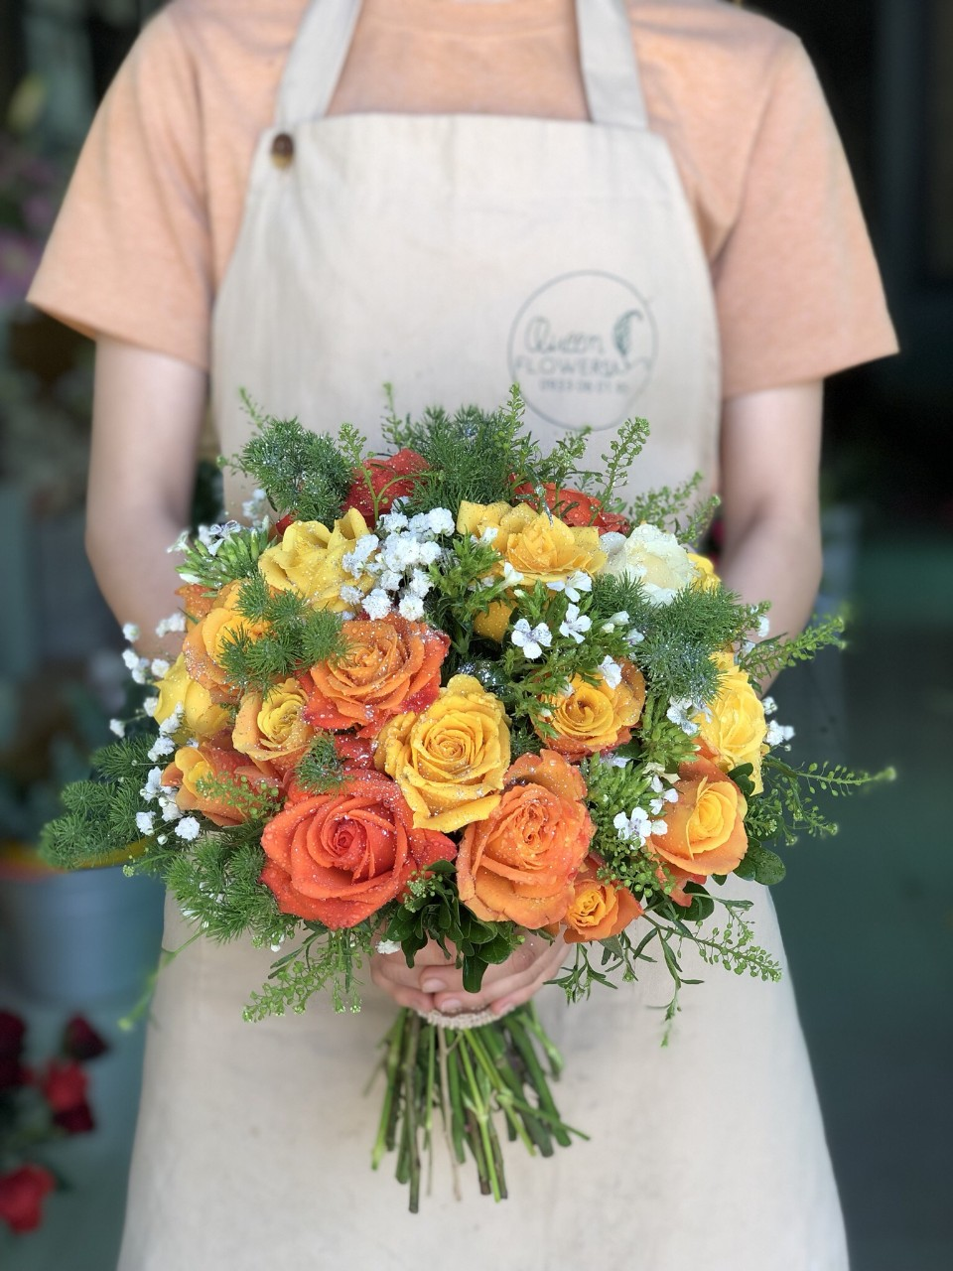
Queen Flowers 0933 06 01 95

Slide 20
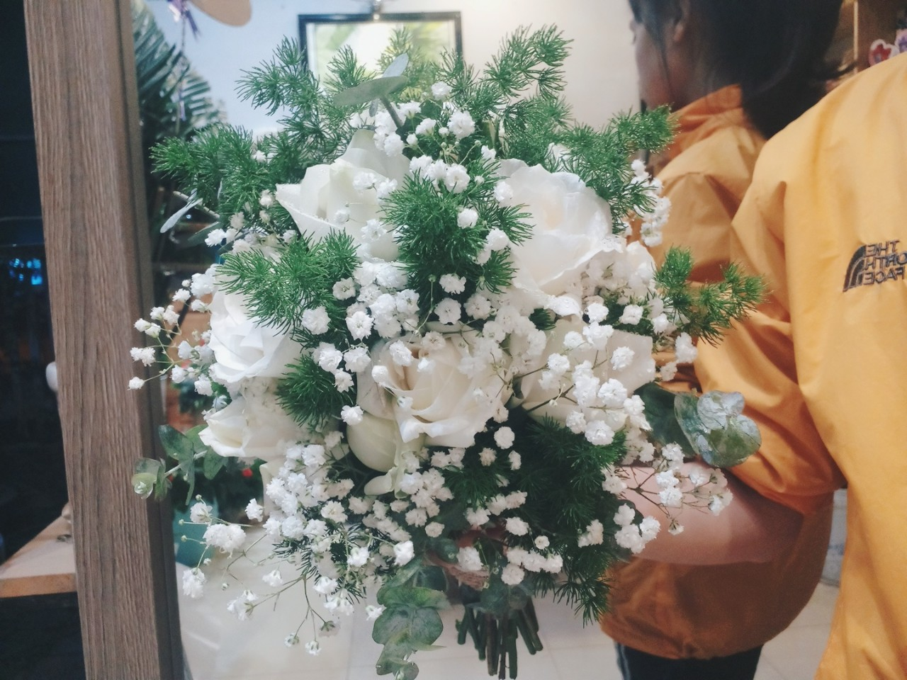
Queen Flowers 0933 06 01 95

Slide 21
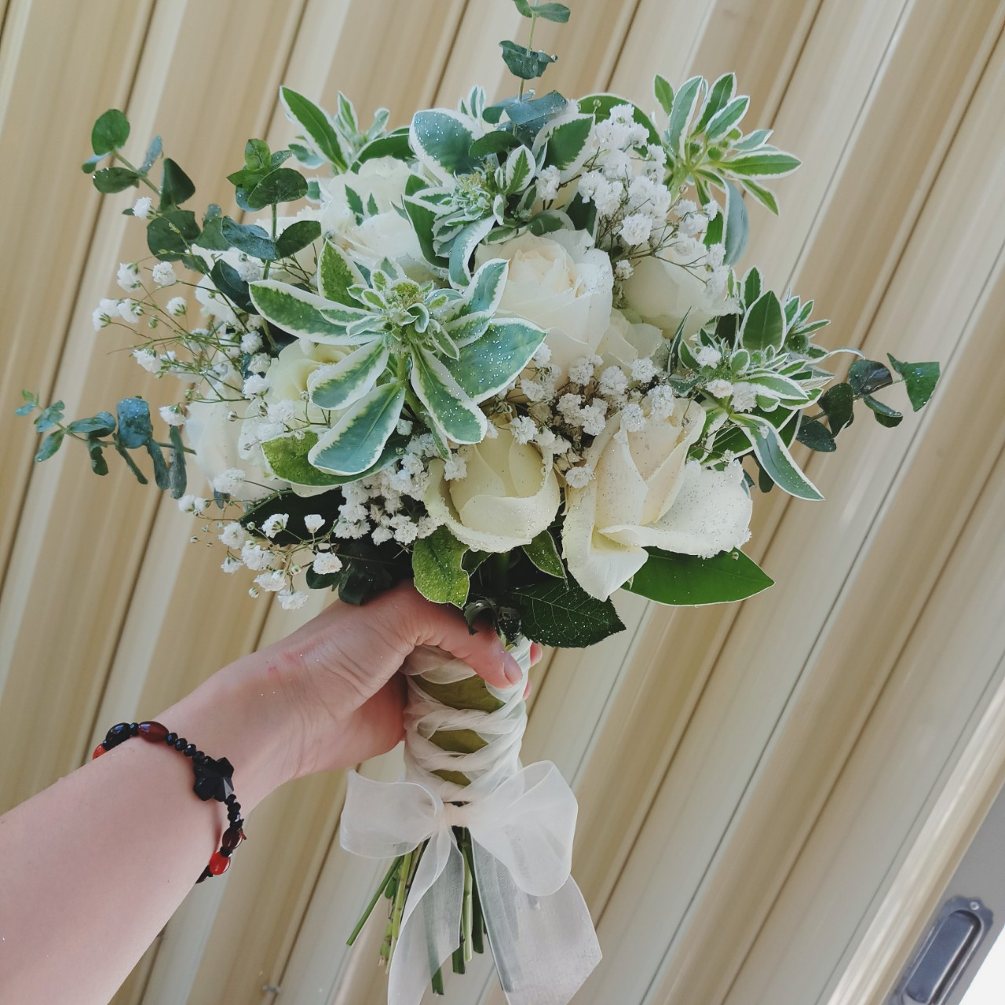
Queen Flowers 0933 06 01 95

Slide 22
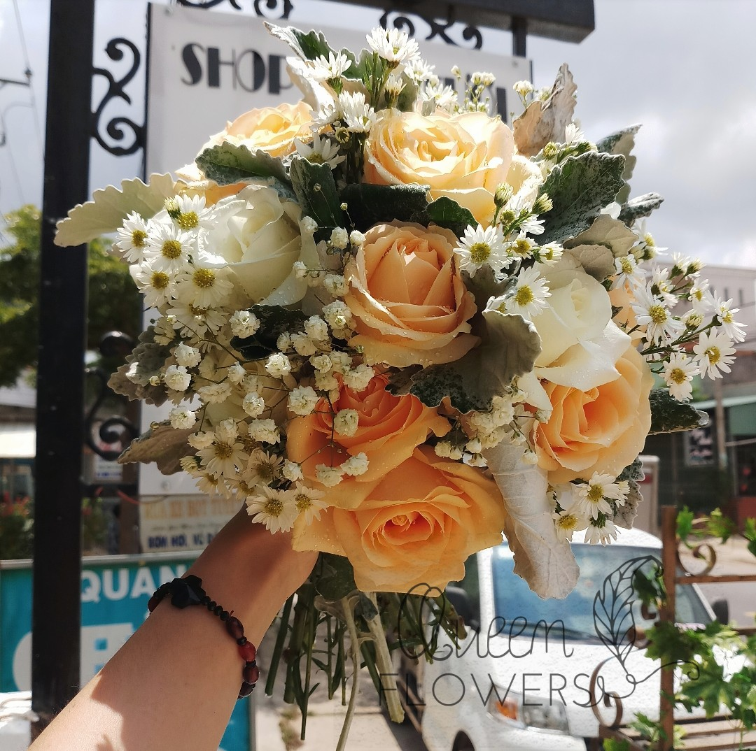
Queen Flowers 0933 06 01 95

Slide 23
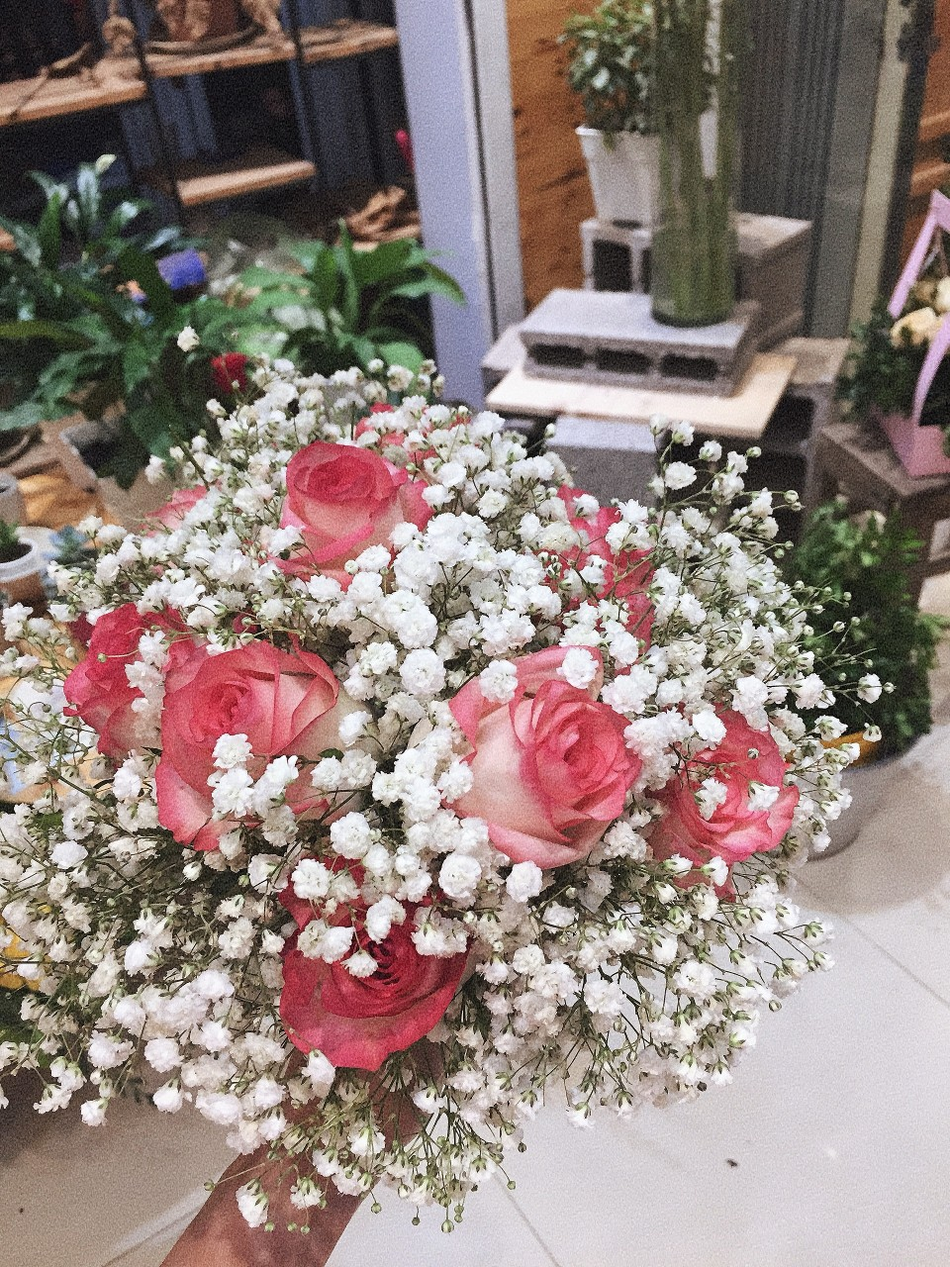
Queen Flowers 0933 06 01 95

Slide 24
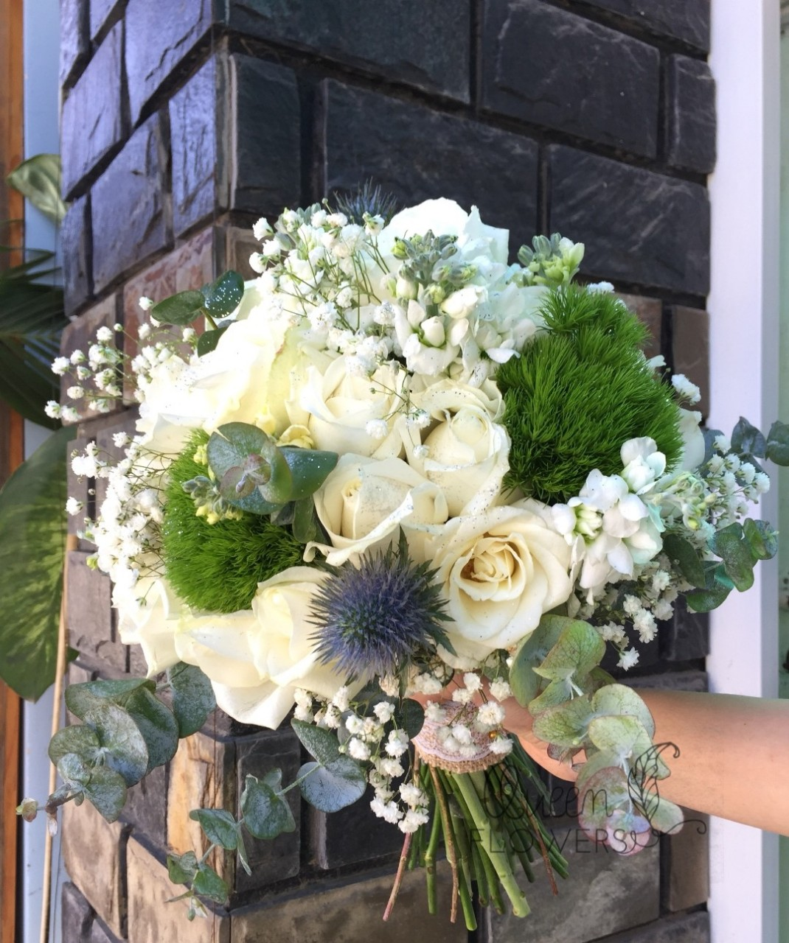
Queen Flowers 0933 06 01 95

Slide 25
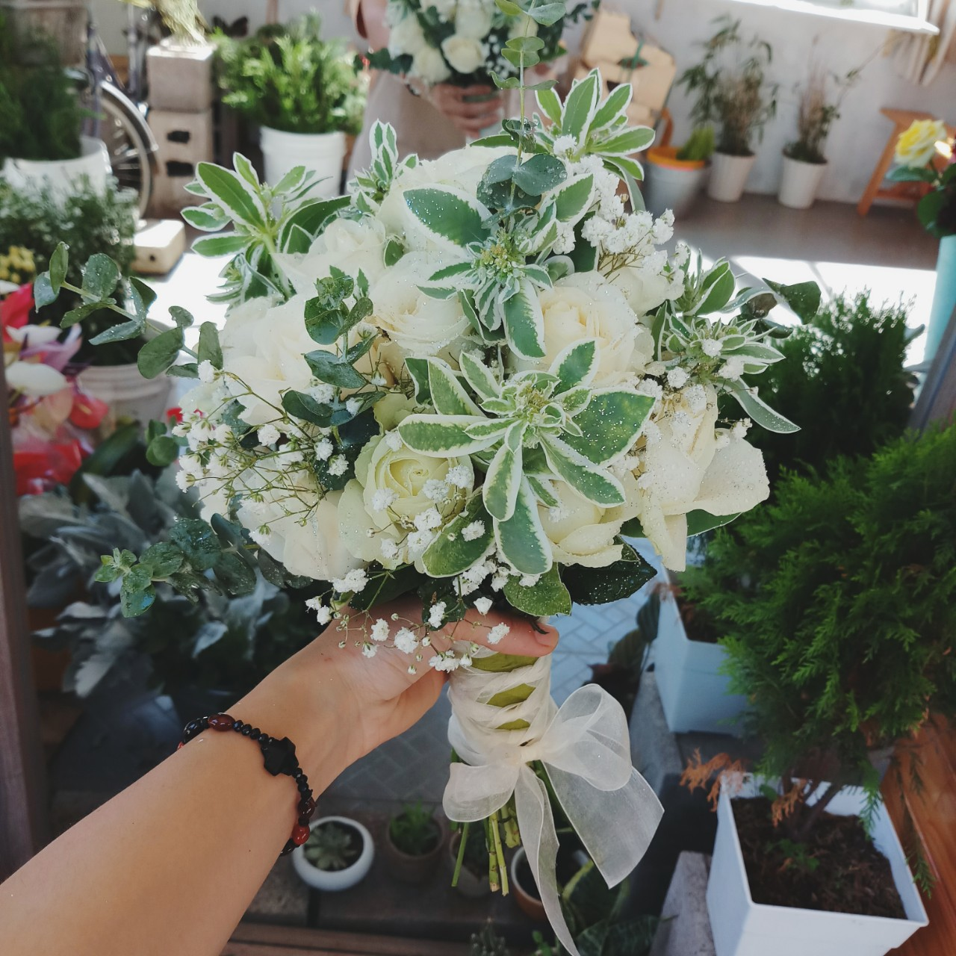
Queen Flowers 0933 06 01 95

Slide 26
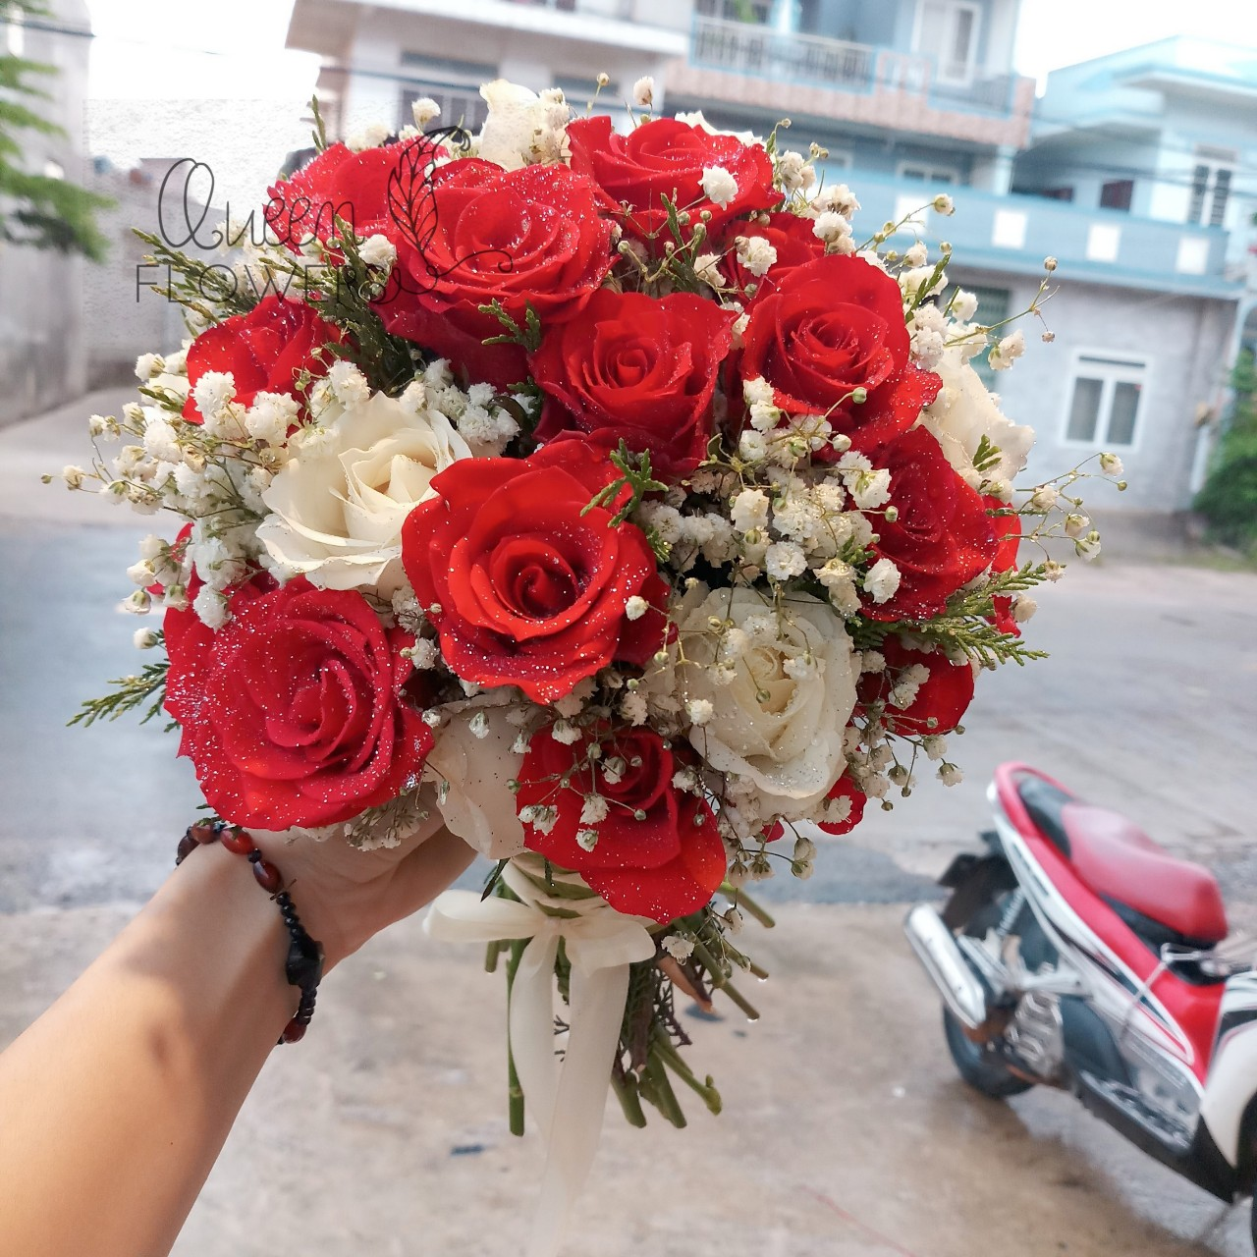
Queen Flowers 0933 06 01 95

Slide 27
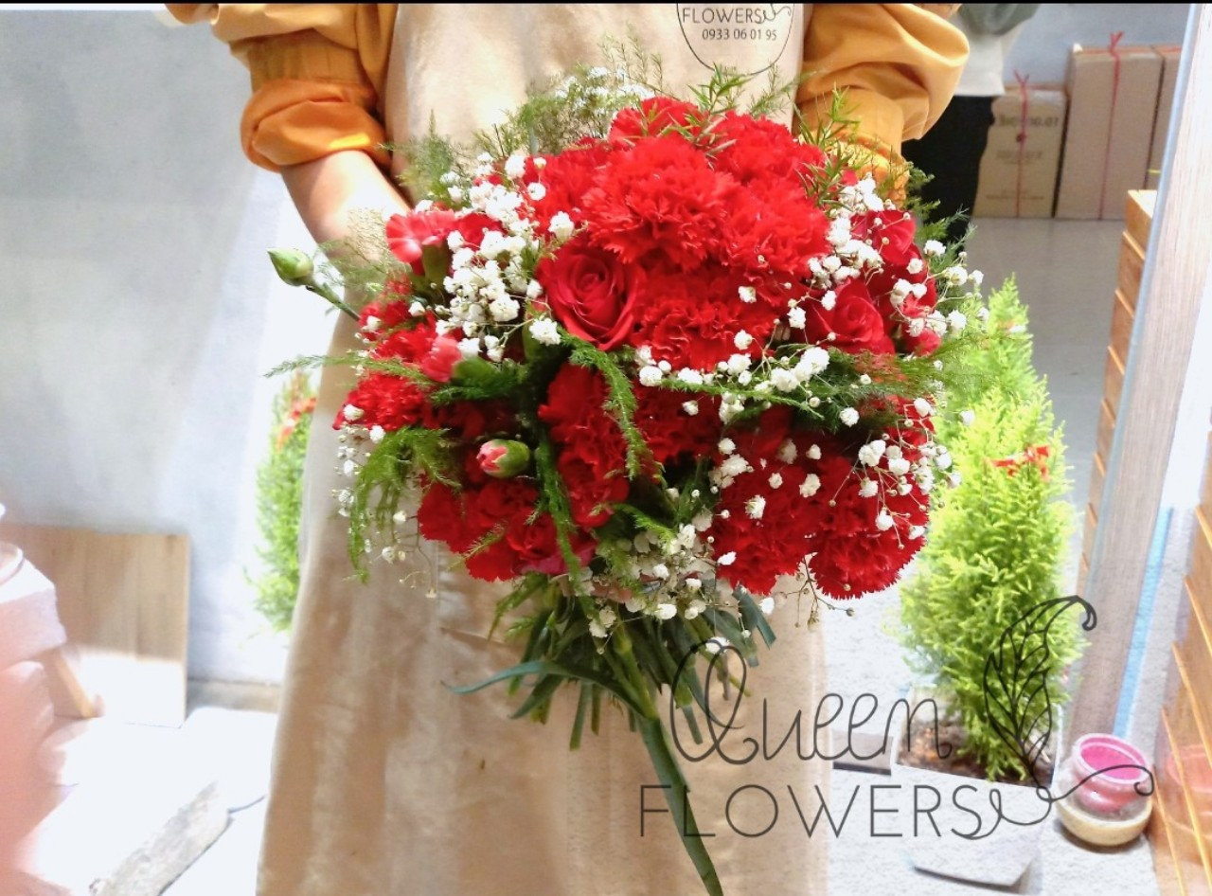
Queen Flowers 0933 06 01 95

Slide 28
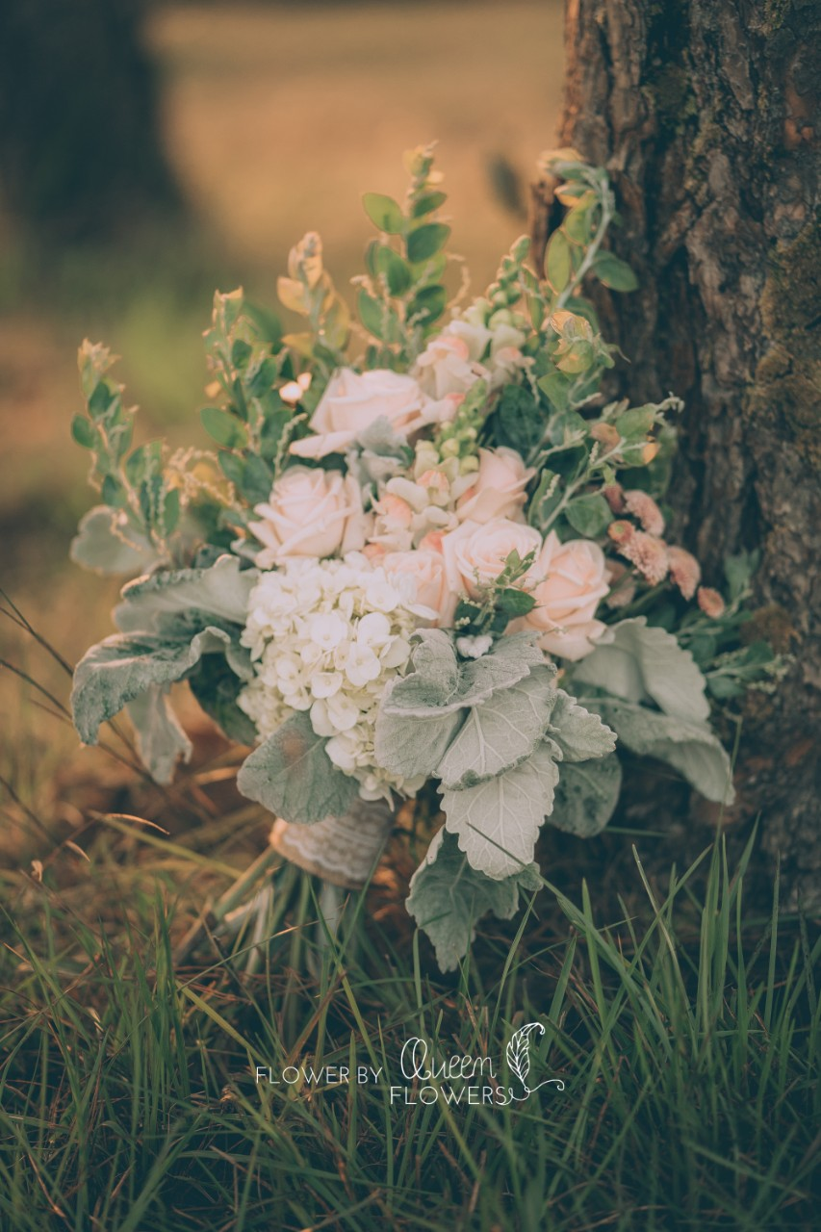
Queen Flowers 0933 06 01 95

Slide 29
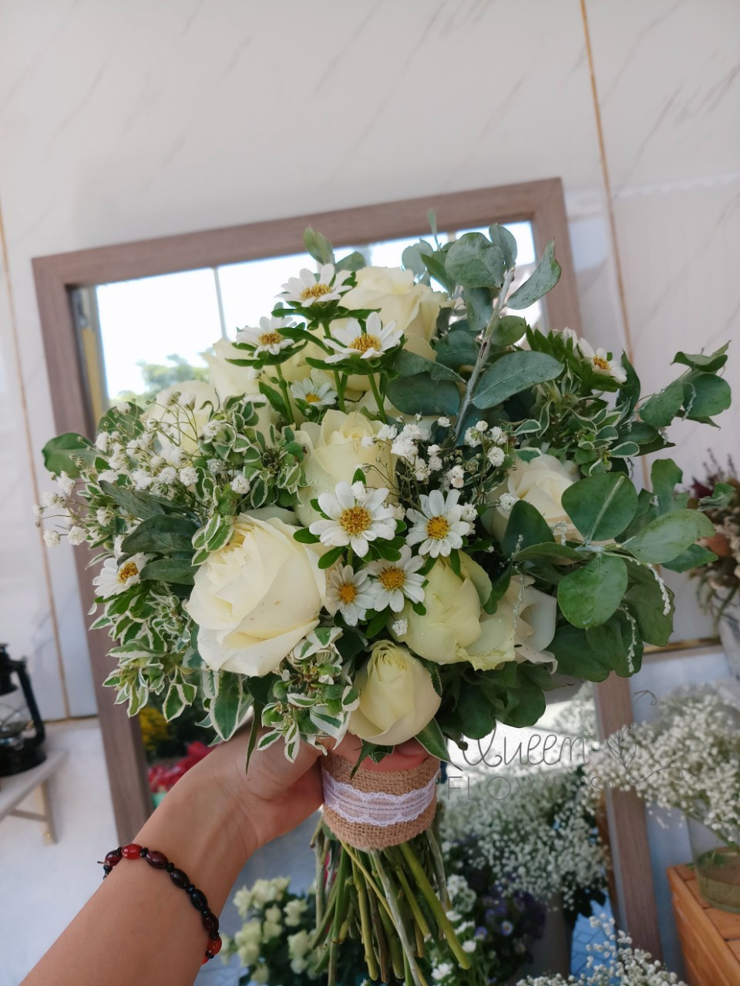
Queen Flowers 0933 06 01 95

Slide 30
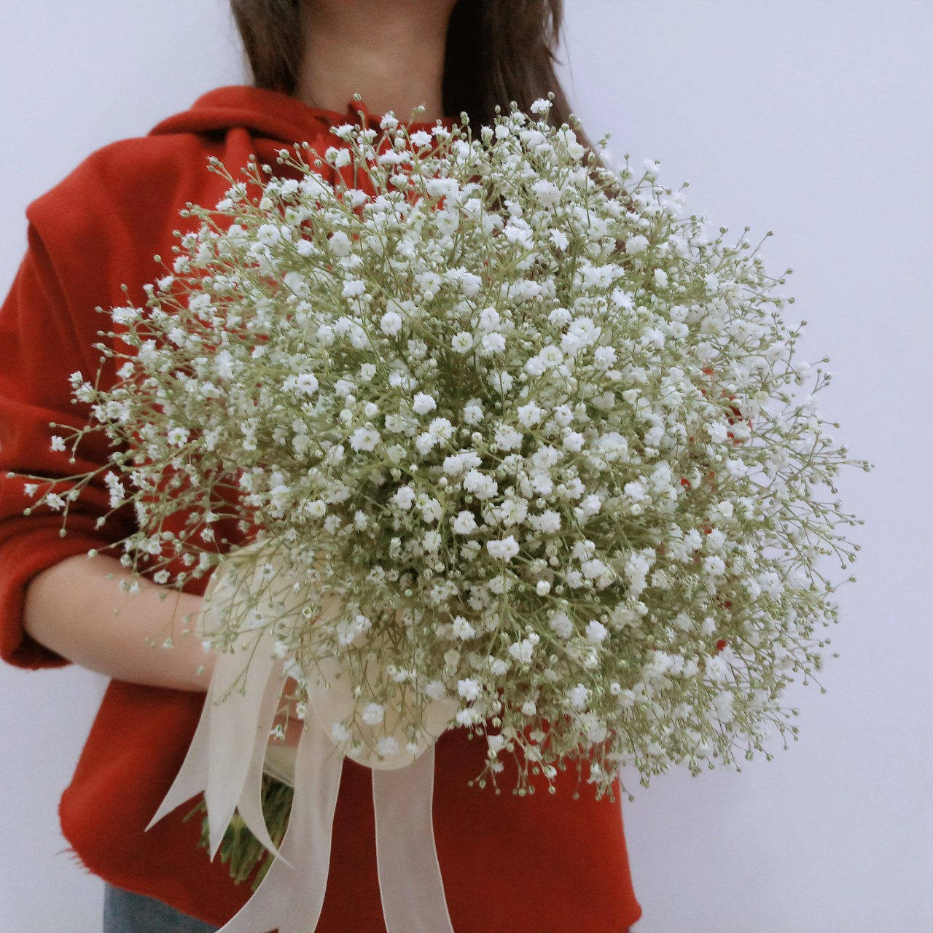
Queen Flowers 0933 06 01 95

Slide 31
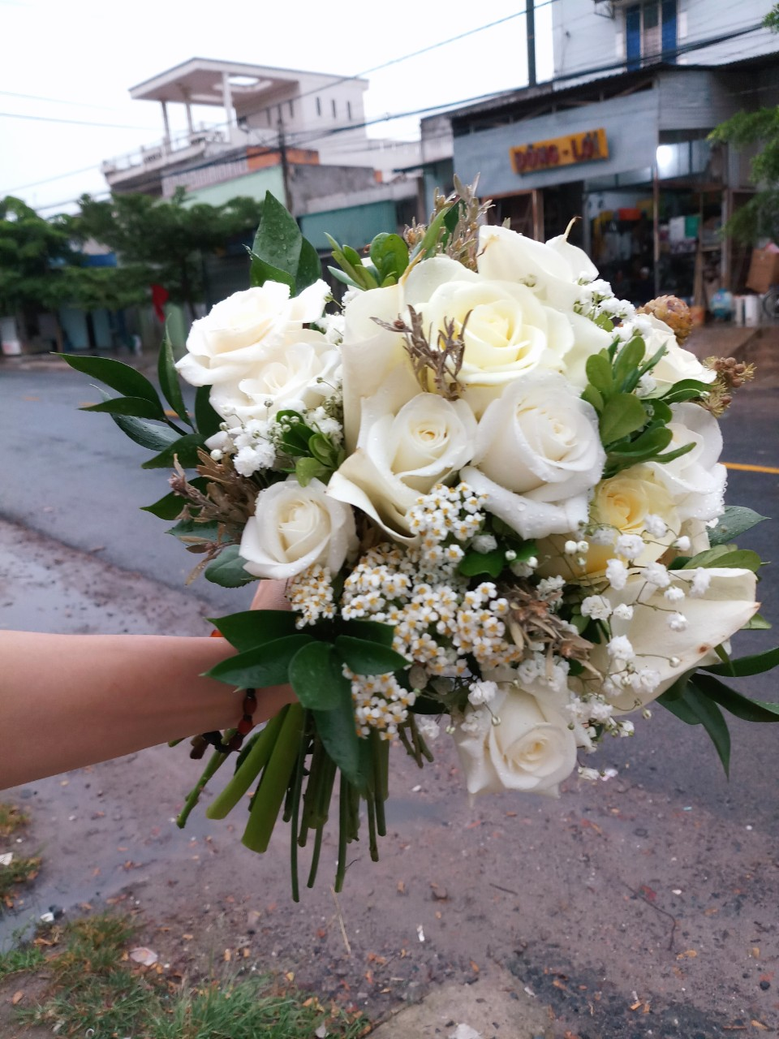
Queen Flowers 0933 06 01 95

Slide 32
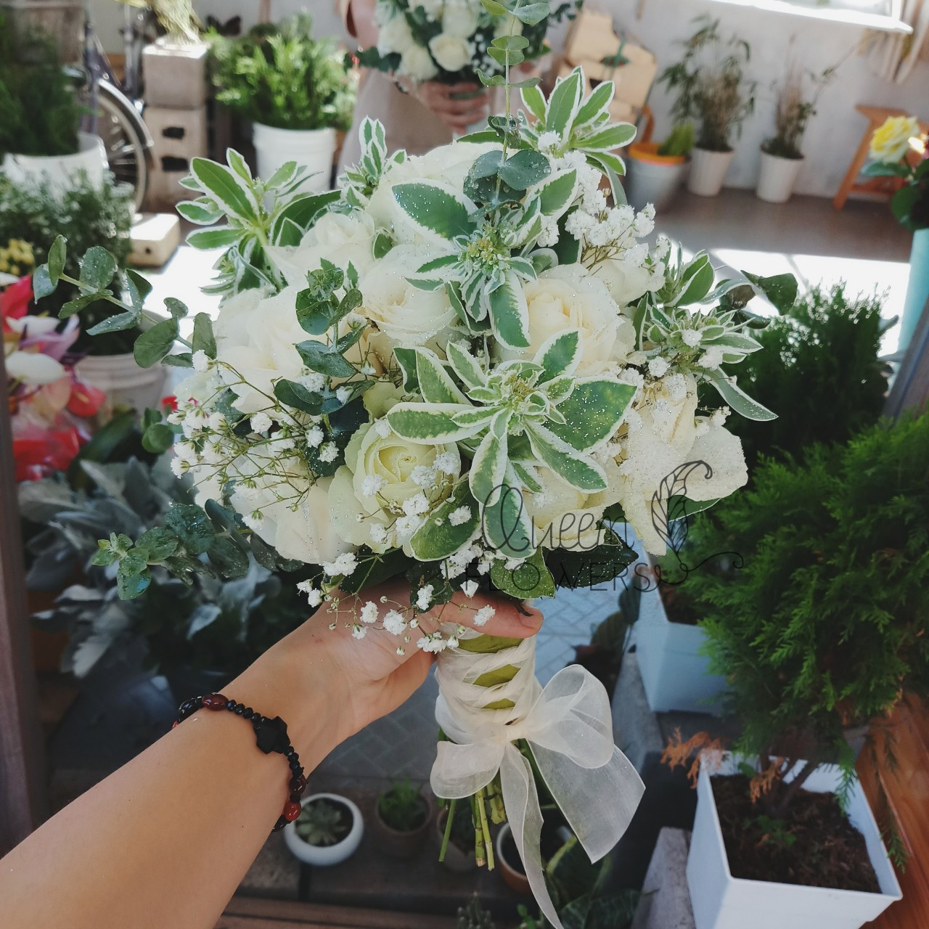
Queen Flowers 0933 06 01 95

Slide 33

Queen Flowers 0933 06 01 95

Slide 34
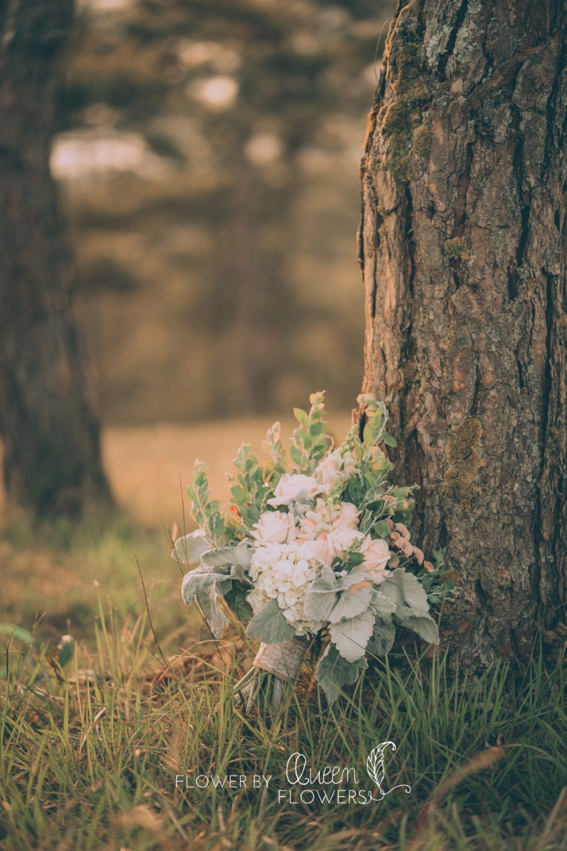
Queen Flowers 0933 06 01 95

Slide 35
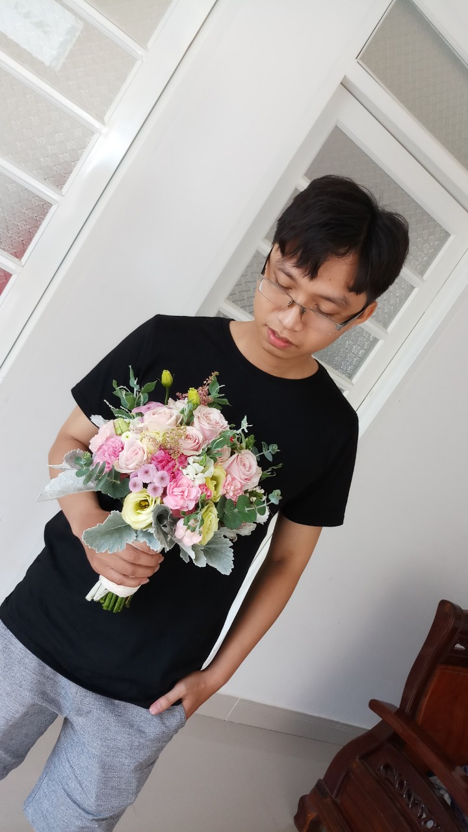
Queen Flowers 0933 06 01 95

Slide 36
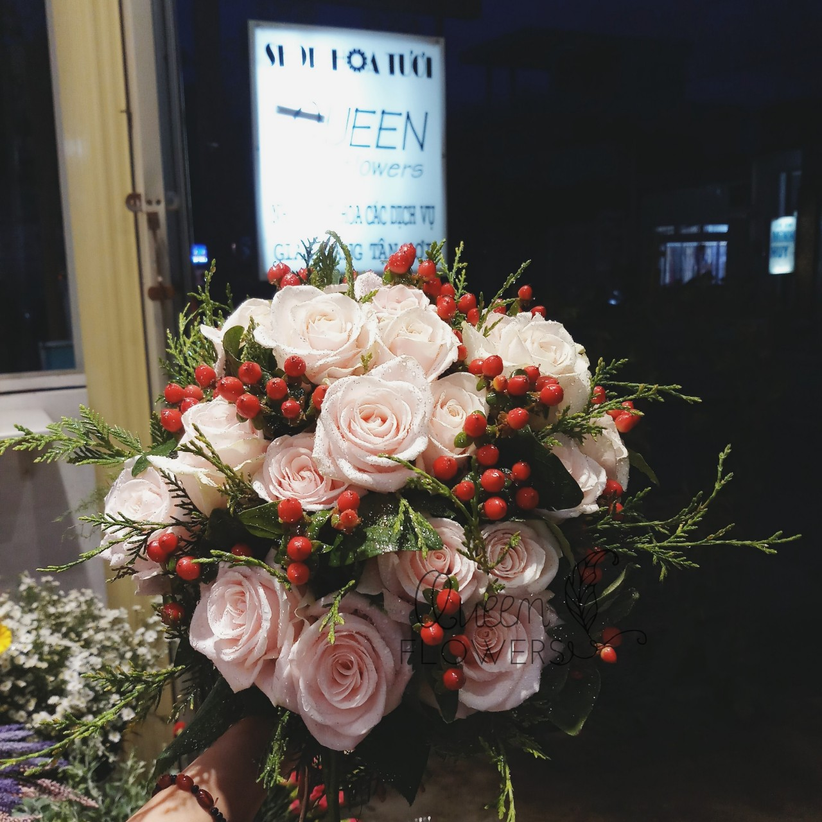
Queen Flowers 0933 06 01 95

Slide 37
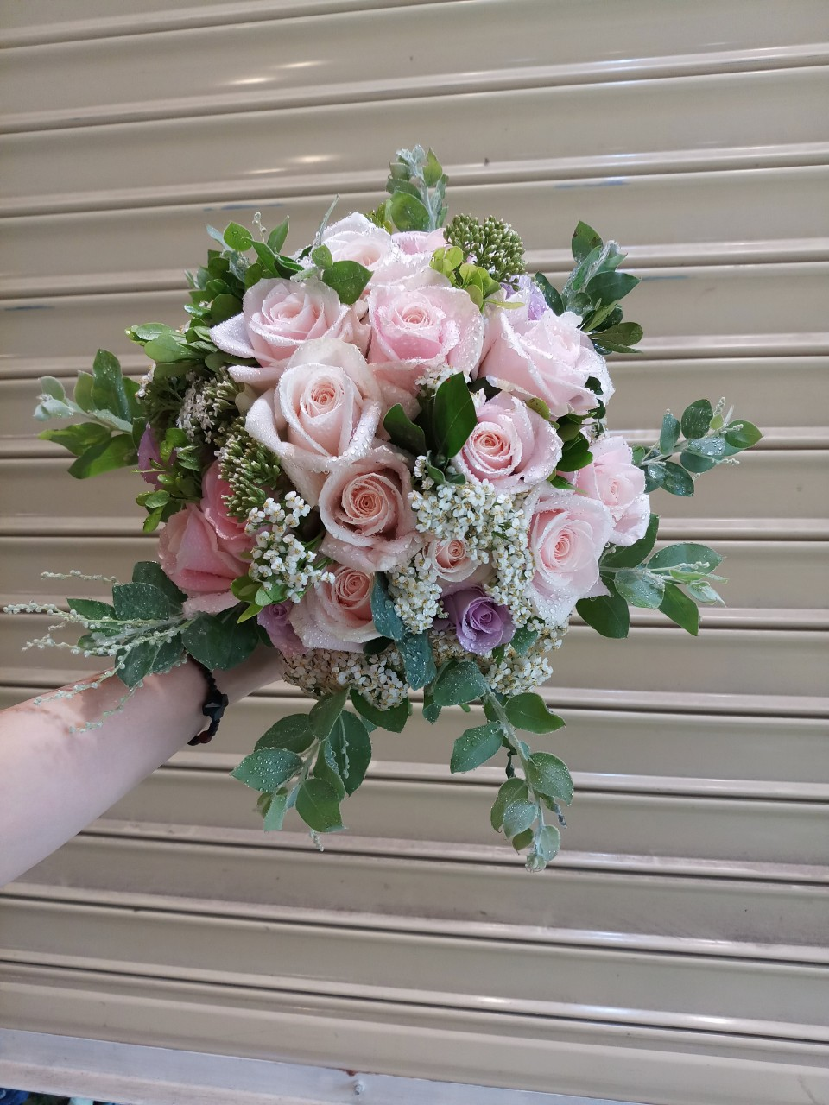
Queen Flowers 0933 06 01 95

Slide 38
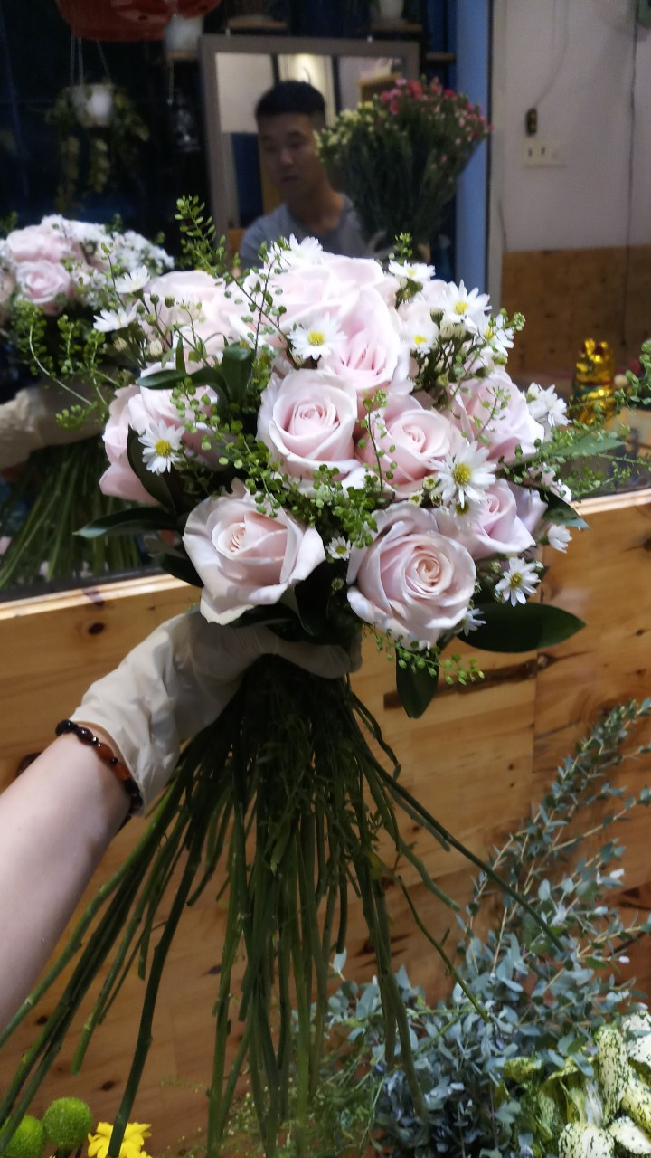
Queen Flowers 0933 06 01 95

Slide 39
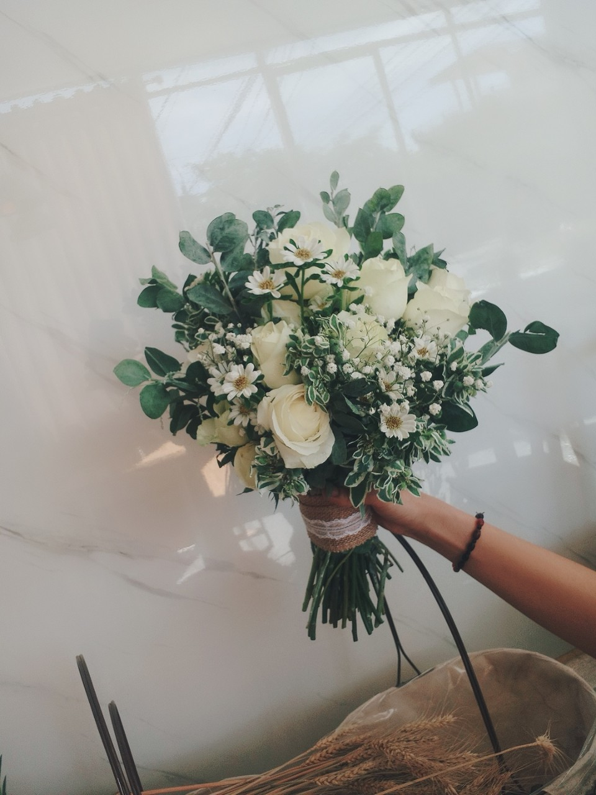
Queen Flowers 0933 06 01 95

Slide 40
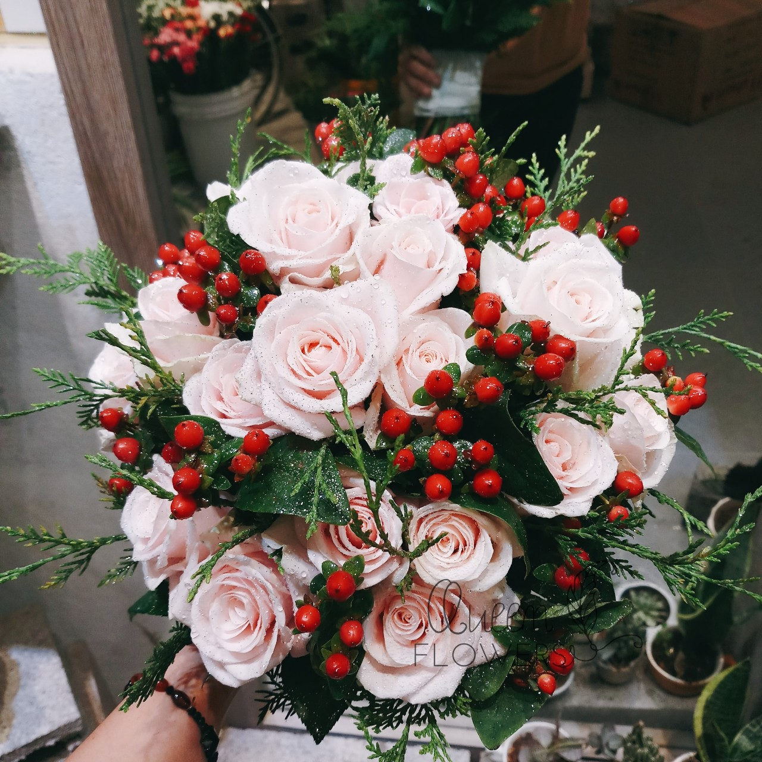
Queen Flowers 0933 06 01 95

Slide 41
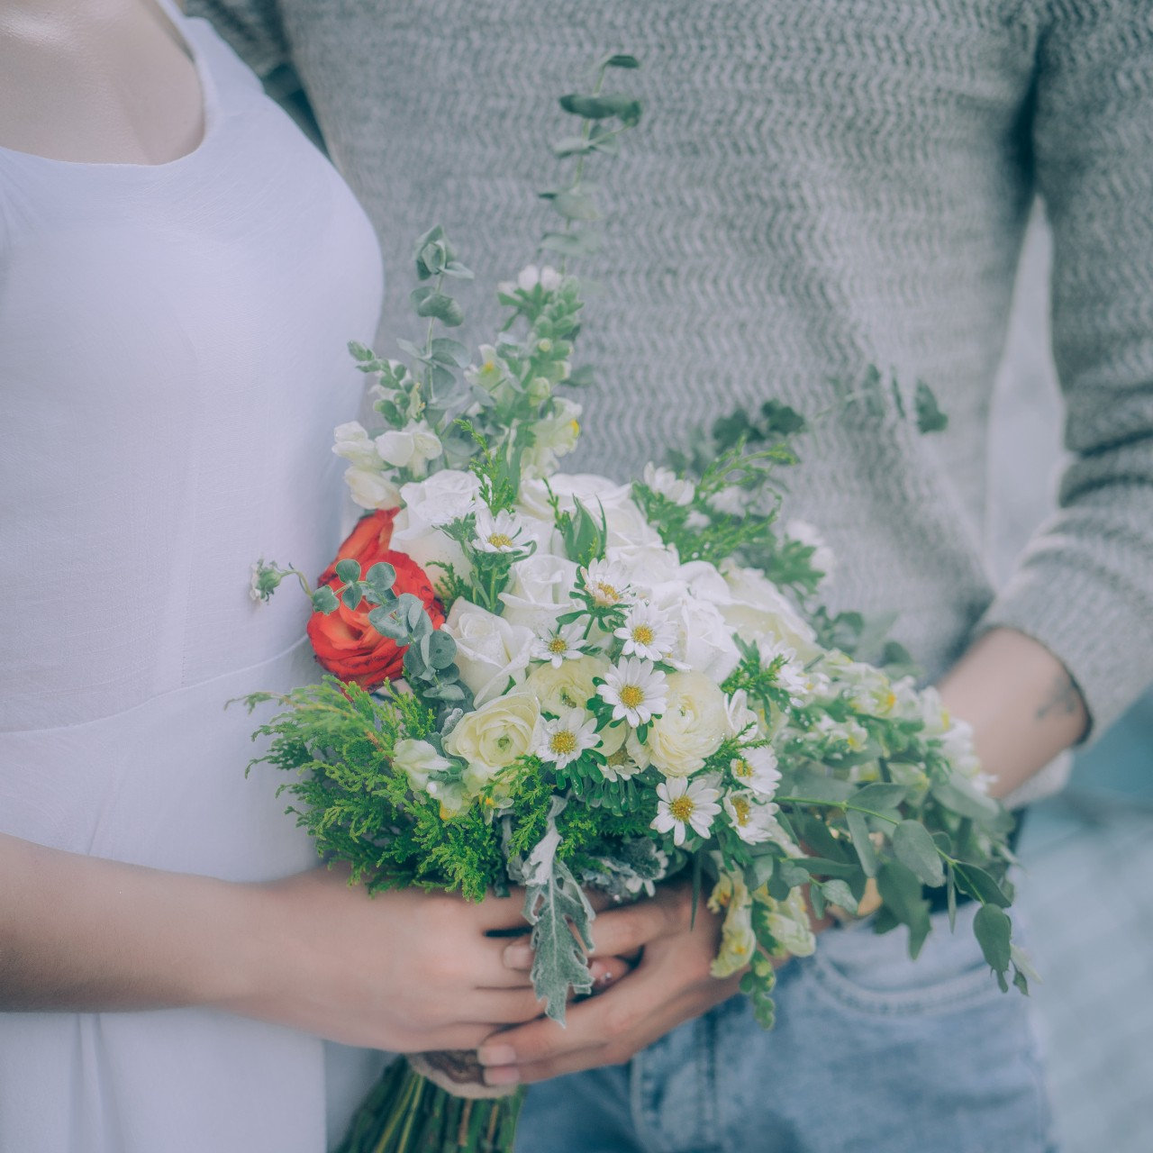
Queen Flowers 0933 06 01 95

Slide 42
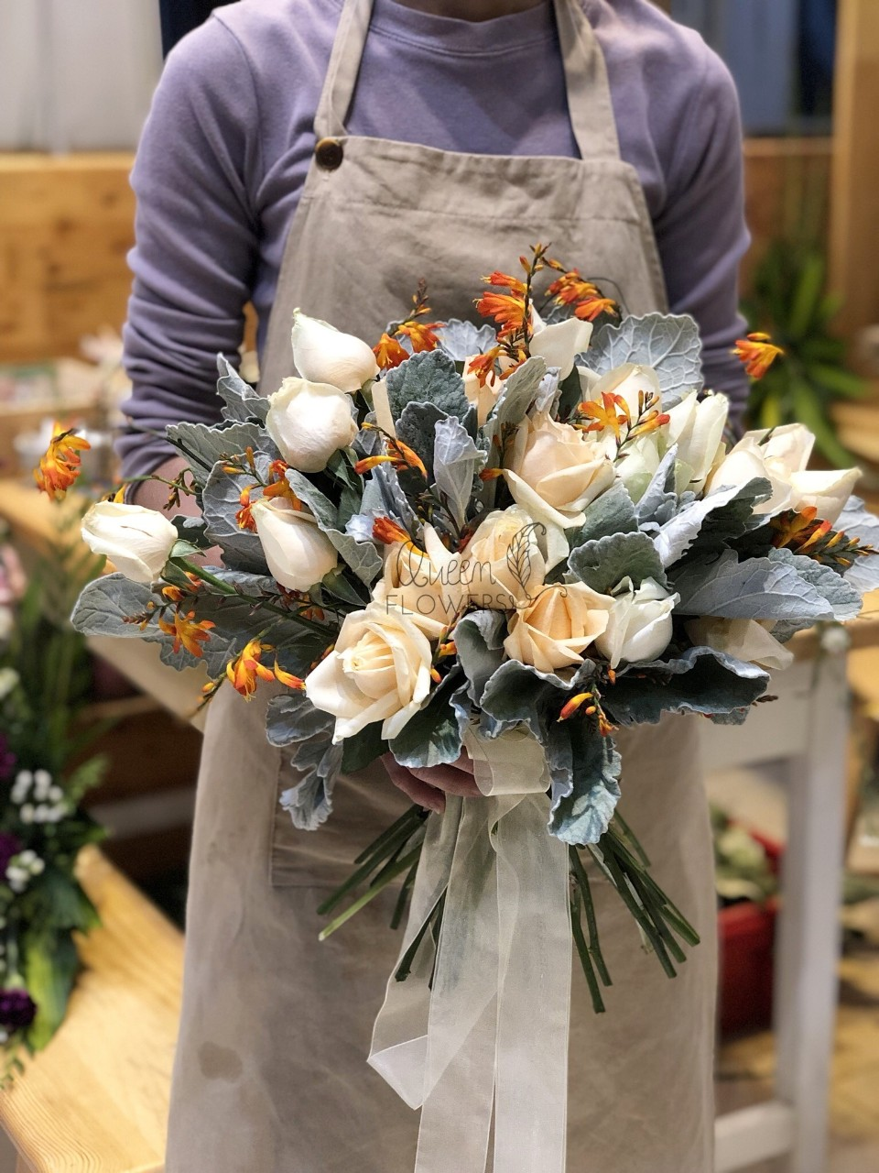
Queen Flowers 0933 06 01 95

Slide 43
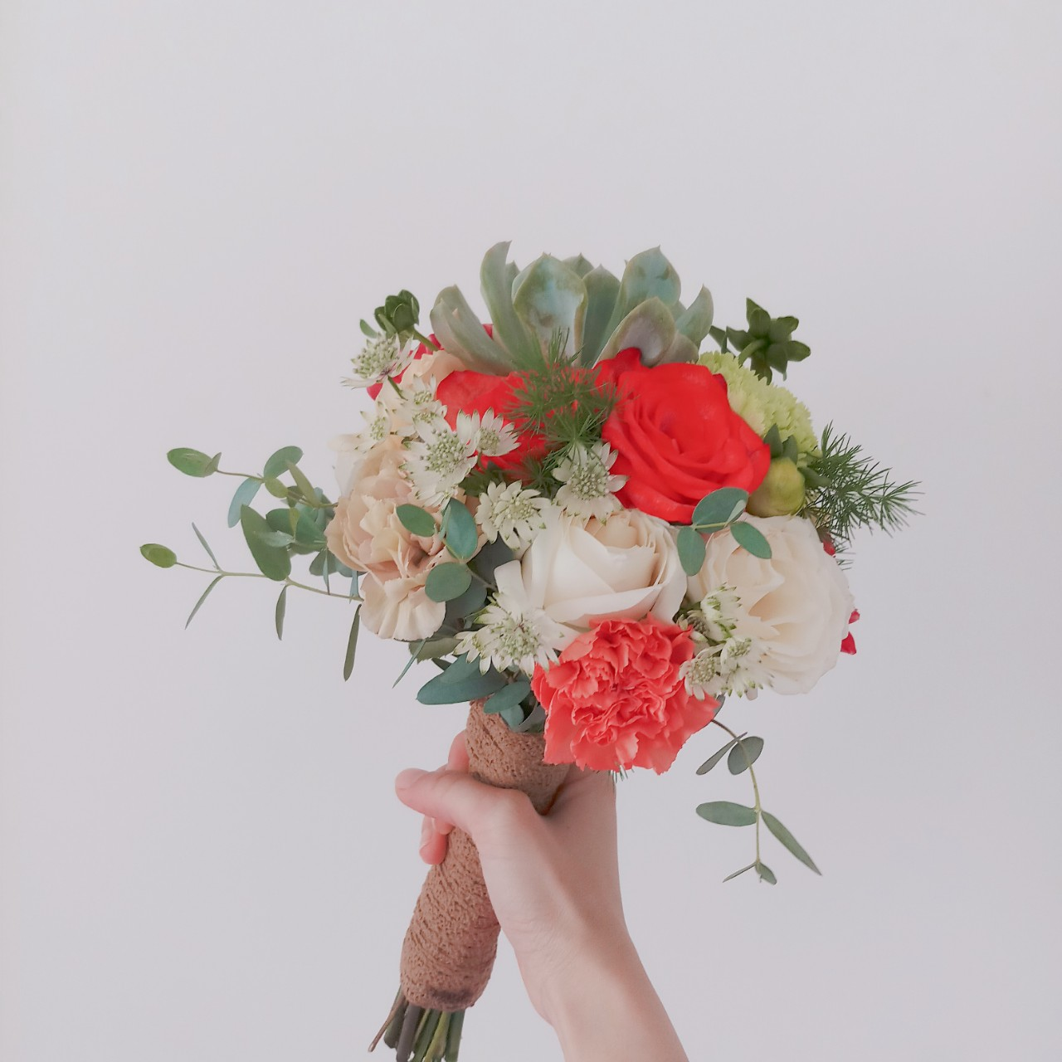
Queen Flowers 0933 06 01 95

Slide 44

Queen Flowers 0933 06 01 95

Slide 45
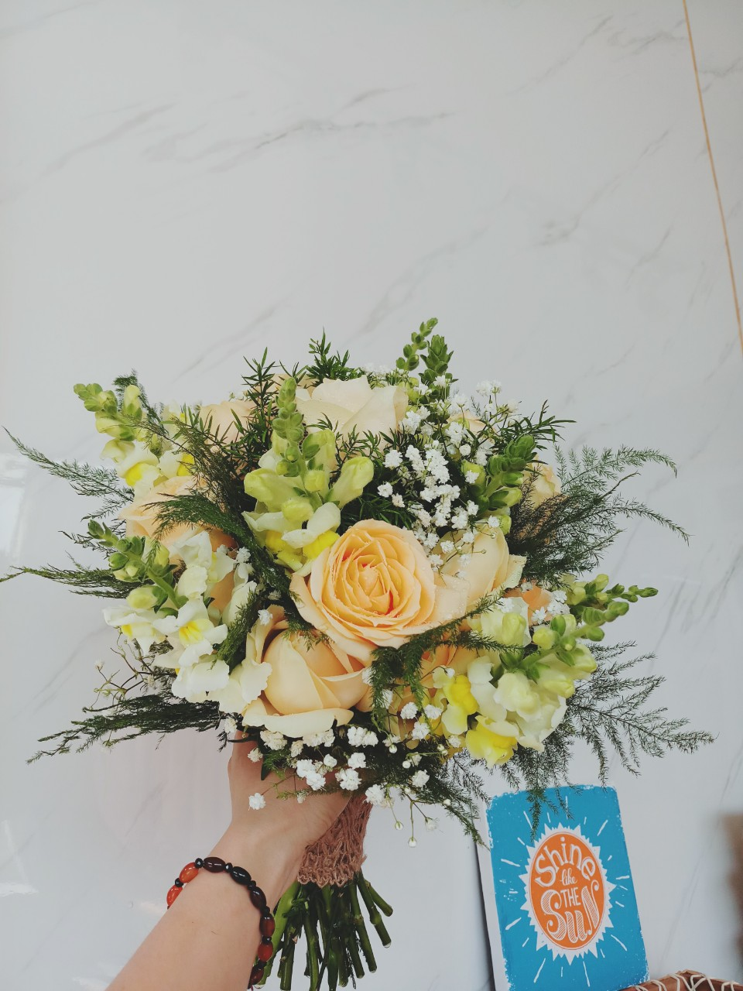
Queen Flowers 0933 06 01 95

Slide 46
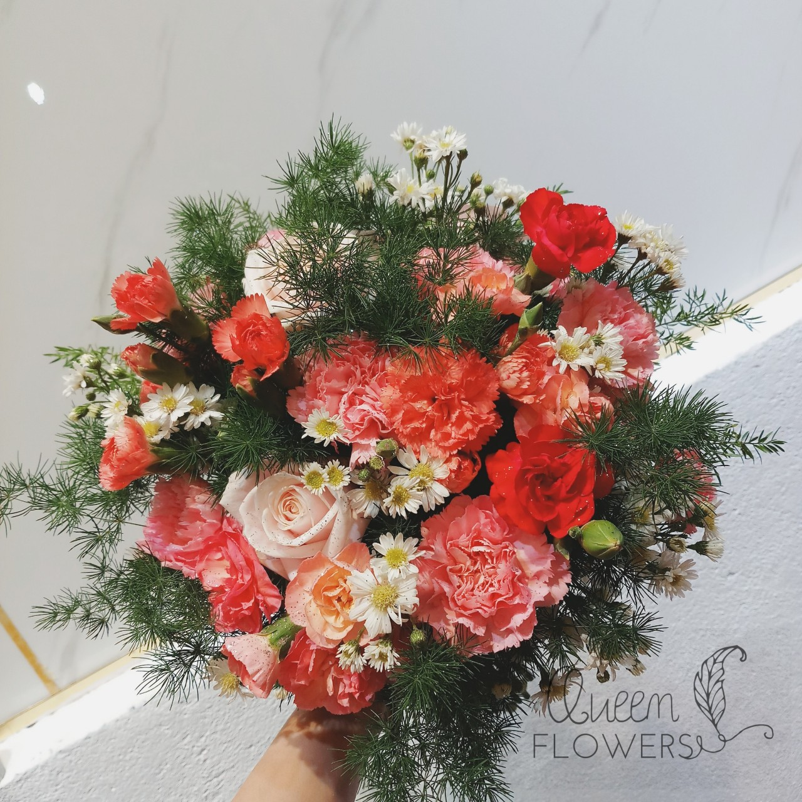
Queen Flowers 0933 06 01 95

Slide 47
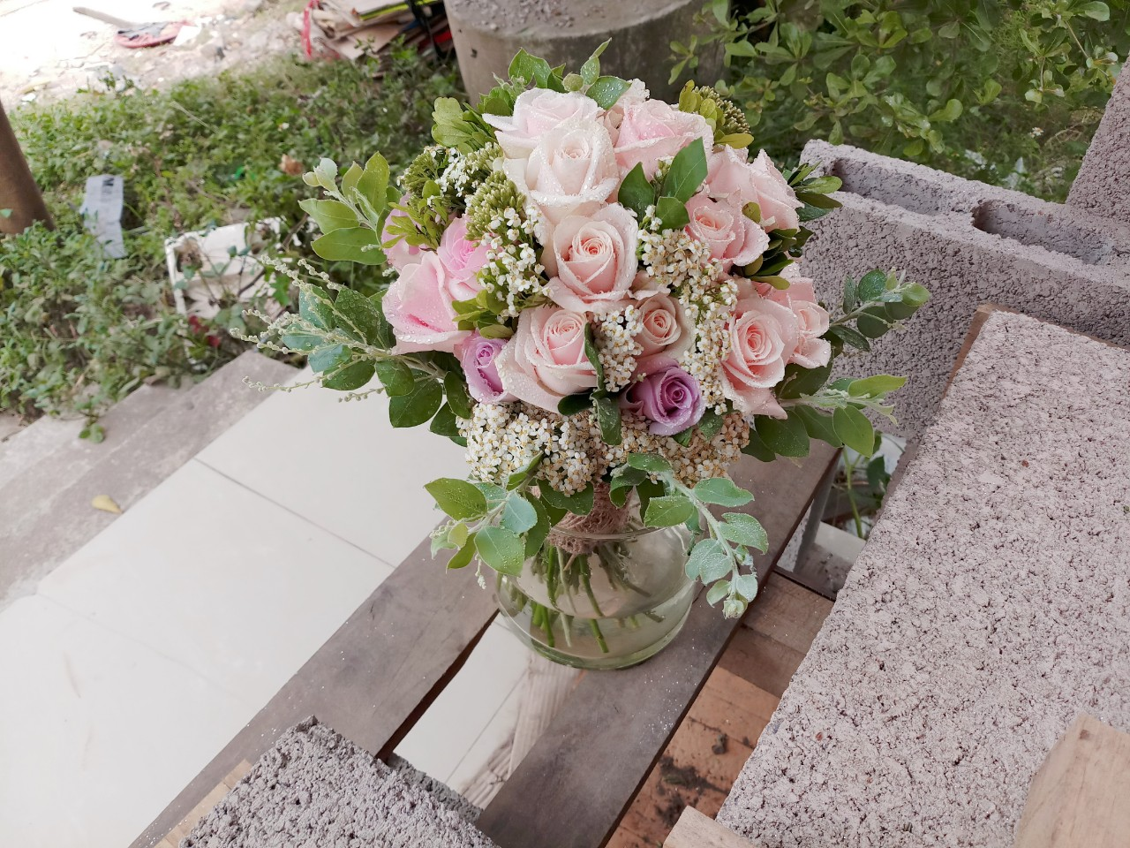
Queen Flowers 0933 06 01 95

Slide 48
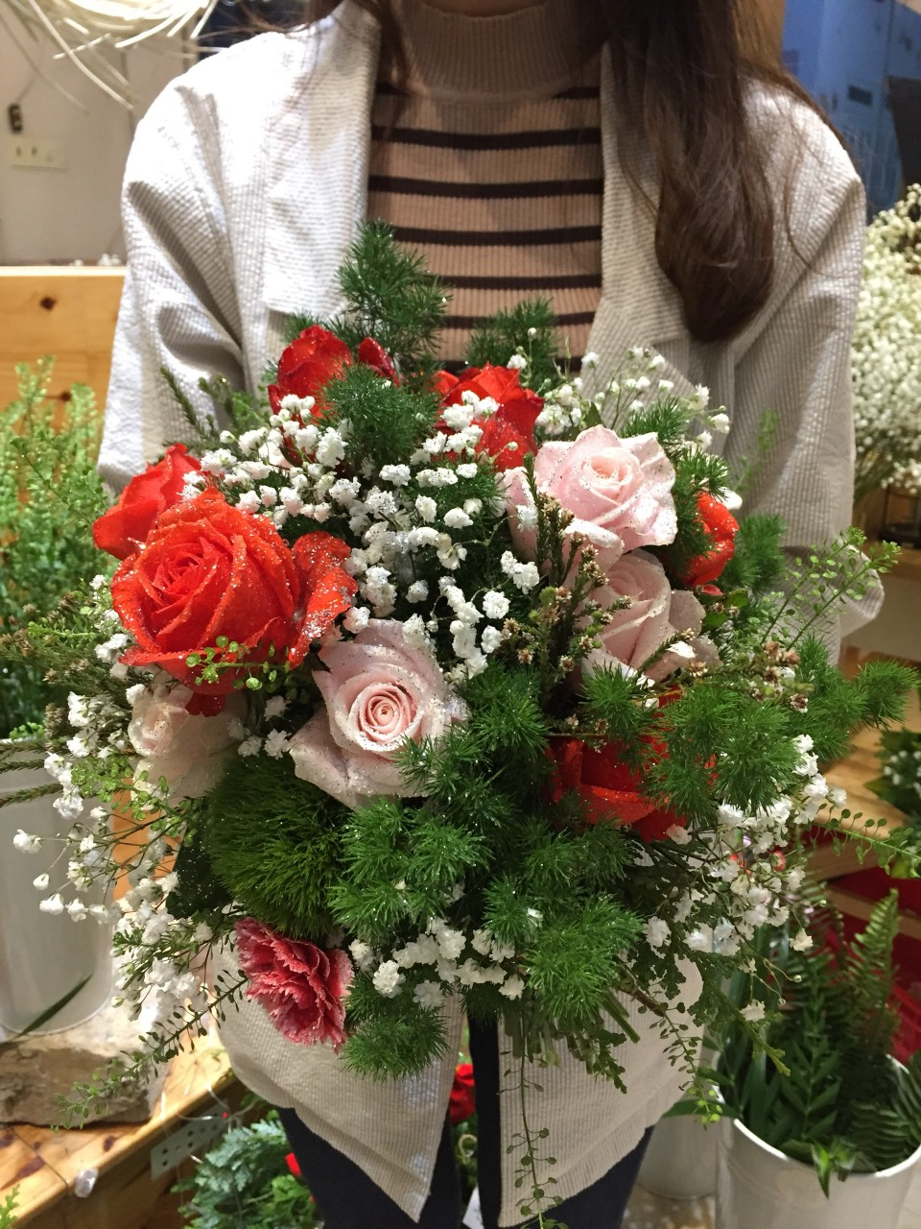
Queen Flowers 0933 06 01 95

Slide 49
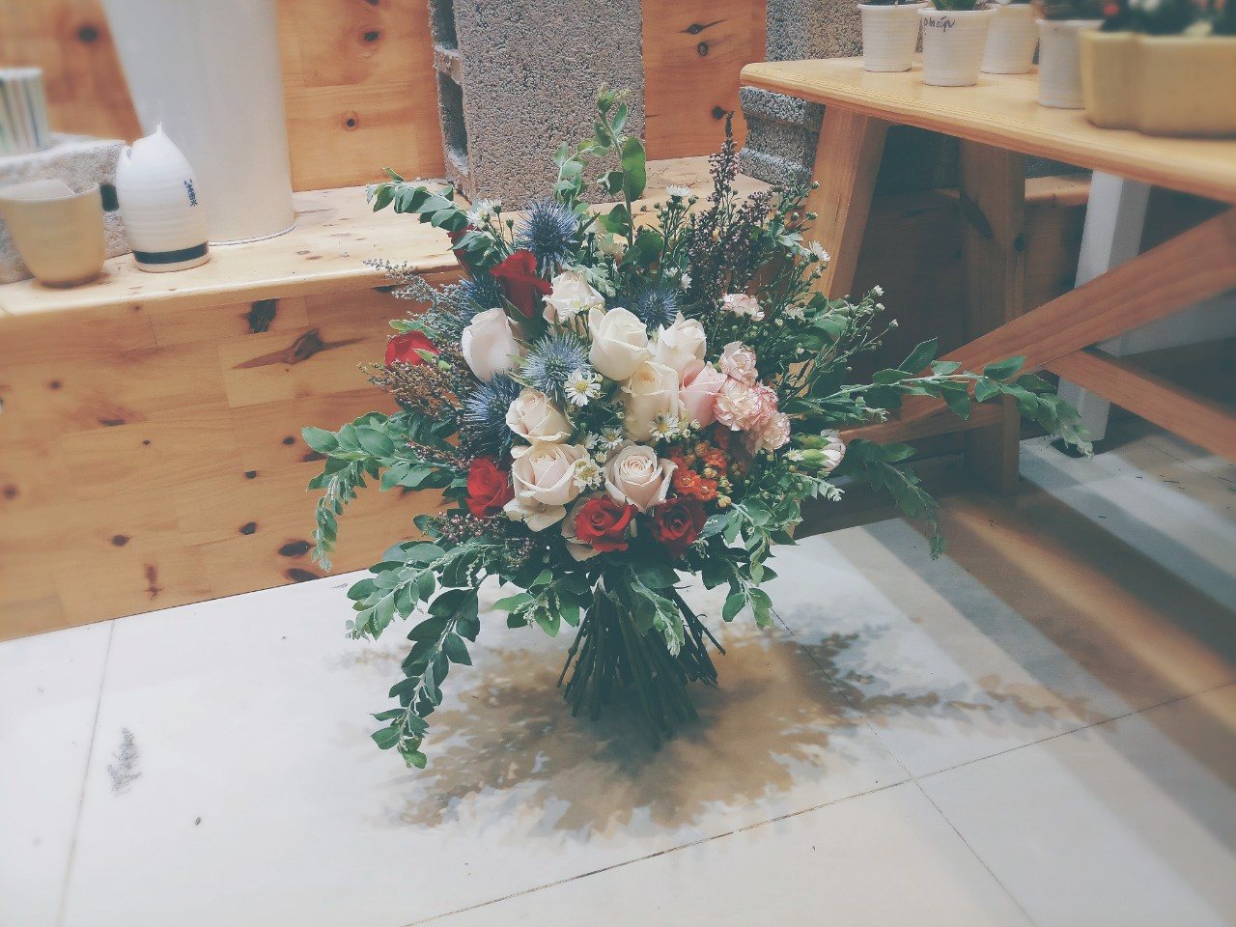
Queen Flowers 0933 06 01 95

Slide 50
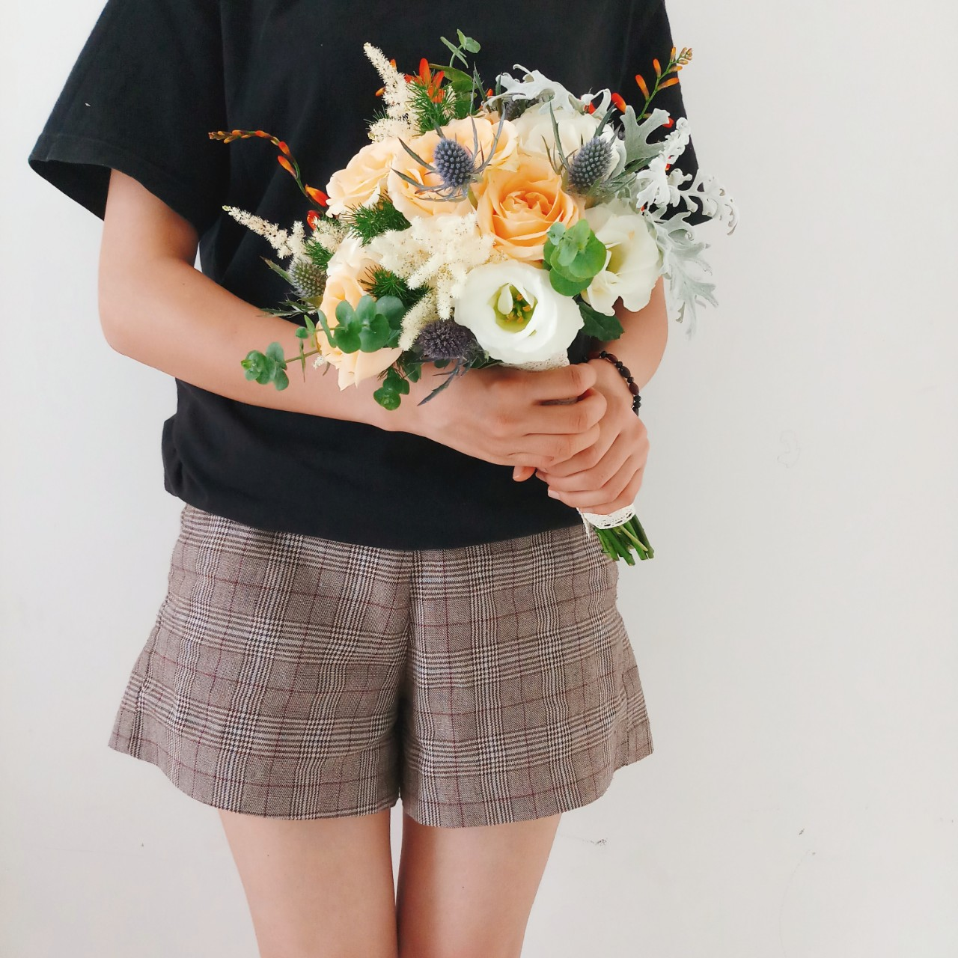
Queen Flowers 0933 06 01 95

Slide 51
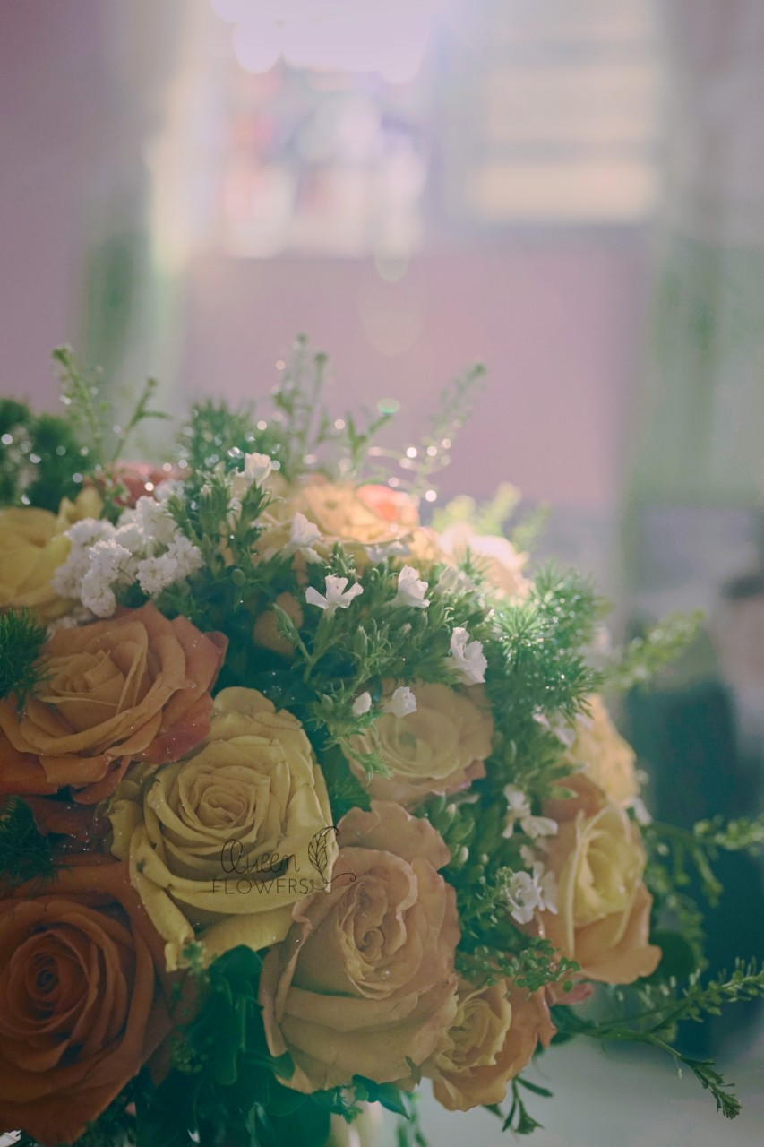
Queen Flowers 0933 06 01 95

Slide 52
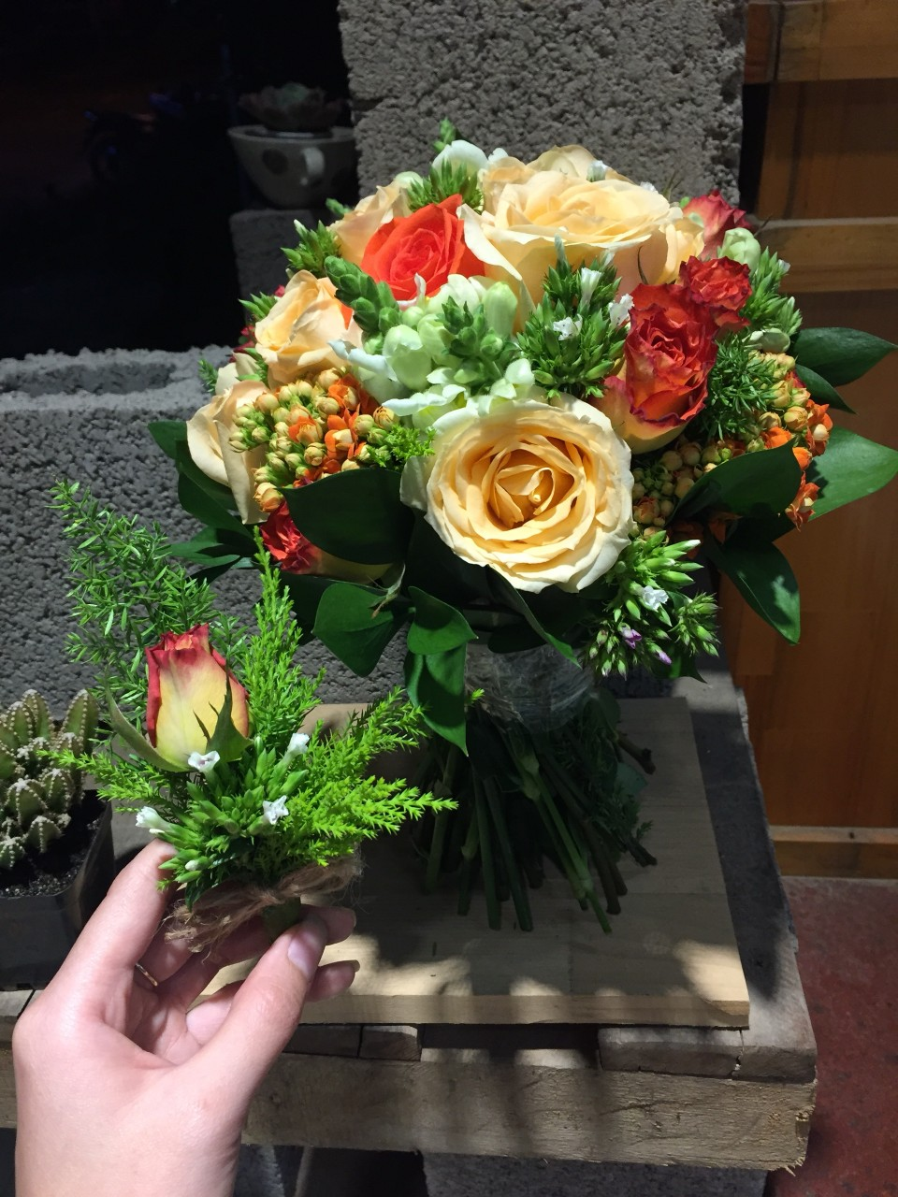
Queen Flowers 0933 06 01 95

Slide 53

Queen Flowers 0933 06 01 95

Slide 54

Queen Flowers 0933 06 01 95

Slide 55

Queen Flowers 0933 06 01 95

Slide 56

Queen Flowers 0933 06 01 95

Slide 57

Queen Flowers 0933 06 01 95

Slide 58

Queen Flowers 0933 06 01 95
Notes:
Hoa cuoi

Slide 60

Queen Flowers 0933 06 01 95
Notes:
Hoa chuc mung

Slide 61

Queen Flowers 0933 06 01 95

Slide 62

Queen Flowers 0933 06 01 95

Slide 63

Queen Flowers 0933 06 01 95

Slide 64

Queen Flowers 0933 06 01 95

Slide 65

Queen Flowers 0933 06 01 95

Slide 66

Queen Flowers 0933 06 01 95

Slide 67

Queen Flowers 0933 06 01 95

Slide 68

Queen Flowers 0933 06 01 95
Notes:
Hoa chuc mung

Slide 70

Queen Flowers 0933 06 01 95
Notes:
Gio hoa

Slide 71

Queen Flowers 0933 06 01 95

Slide 72

Queen Flowers 0933 06 01 95

Slide 73

Queen Flowers 0933 06 01 95

Slide 74

Queen Flowers 0933 06 01 95

Slide 75

Queen Flowers 0933 06 01 95

Slide 76

Queen Flowers 0933 06 01 95

Slide 77

Queen Flowers 0933 06 01 95

Slide 78

Queen Flowers 0933 06 01 95

Slide 79

Queen Flowers 0933 06 01 95

Slide 80

Queen Flowers 0933 06 01 95

Slide 81

Queen Flowers 0933 06 01 95

Slide 82

Queen Flowers 0933 06 01 95

Slide 83

Queen Flowers 0933 06 01 95

Slide 84

Queen Flowers 0933 06 01 95

Slide 85
Queen Flowers 0933 06 01 95

Slide 86

Queen Flowers 0933 06 01 95

Slide 87

Queen Flowers 0933 06 01 95

Slide 88

Queen Flowers 0933 06 01 95

Slide 89

Queen Flowers 0933 06 01 95

Slide 90

Queen Flowers 0933 06 01 95

Slide 91

Queen Flowers 0933 06 01 95

Slide 92

Queen Flowers 0933 06 01 95

Slide 93

Queen Flowers 0933 06 01 95

Slide 94

Queen Flowers 0933 06 01 95

Slide 95

Queen Flowers 0933 06 01 95

Slide 96

Queen Flowers 0933 06 01 95

Slide 97

Queen Flowers 0933 06 01 95

Slide 98

Queen Flowers 0933 06 01 95

Slide 99

Queen Flowers 0933 06 01 95

Slide 100

Queen Flowers 0933 06 01 95

Slide 101

Queen Flowers 0933 06 01 95

Slide 102

Queen Flowers 0933 06 01 95

Slide 103

Queen Flowers 0933 06 01 95

Slide 104

Queen Flowers 0933 06 01 95

Slide 105

Queen Flowers 0933 06 01 95

Slide 106

Queen Flowers 0933 06 01 95

Slide 107

Queen Flowers 0933 06 01 95

Slide 108

Queen Flowers 0933 06 01 95

Slide 109

Queen Flowers 0933 06 01 95

Slide 110

Queen Flowers 0933 06 01 95

Slide 111

Queen Flowers 0933 06 01 95

Slide 112

Queen Flowers 0933 06 01 95

Slide 113

Queen Flowers 0933 06 01 95

Slide 114

Queen Flowers 0933 06 01 95

Slide 115

Queen Flowers 0933 06 01 95

Slide 116

Queen Flowers 0933 06 01 95

Slide 117

Queen Flowers 0933 06 01 95

Slide 118

Queen Flowers 0933 06 01 95

Slide 119

Queen Flowers 0933 06 01 95

Slide 120

Queen Flowers 0933 06 01 95

Slide 121

Queen Flowers 0933 06 01 95

Slide 122

Queen Flowers 0933 06 01 95

Slide 123

Queen Flowers 0933 06 01 95

Slide 124

Queen Flowers 0933 06 01 95

Slide 125
Queen Flowers 0933 06 01 95

Slide 126

Queen Flowers 0933 06 01 95
Notes:
Gio hoa

